Slide 1
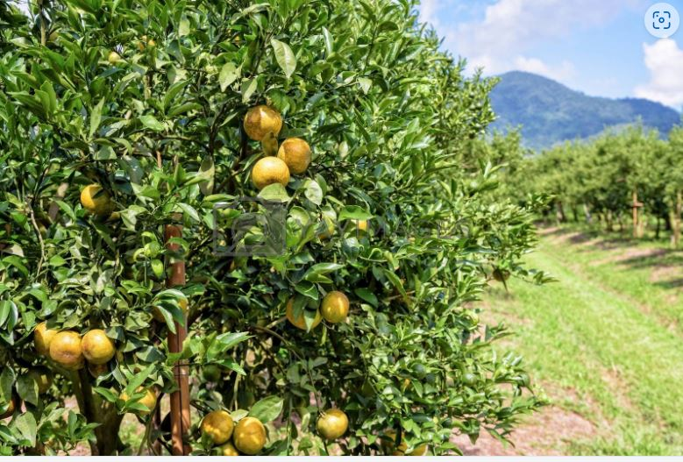
CALIFORNIA CITRUS NURSERY BOARD(CCNB)
9/27/2024
Dr. Douglas Hill
President of Technology Evolving Solutions
In Collaboration with
Dr. Georgios Vidalakis
Director of Citrus Clonal Protection Program (CCPP)
at the University of California Riverside

Slide 2





Acknowledgements
Ryan Milton, TES
Axel Mounkam, TES
Anthony DeLaTorre, TES
Timothy Williams, TES
Catherine Hill, TES
Manoel Tamraz, TES
Jacob Rider, TES
Adam Veres, TES
Alan Melendez, TES
Georgios Vidalakis, UCR-CCPP
Deborah Pagliaccia, UCR
Sohrab Bodaghi, UCR
Subhas Hajeri, CCTEA
Mamoudou Setamou, TAMUK
Lucita (Luci) Kamagai, CDFA
Rock Christiano, CCPP-Lindcove
Irene Lavagi-Craddock,UCR-Rubidoux
Greg Greer, UCR, CCPP-Rubidoux
Without the Support of Dr. Georgios Vidalakis and his team, this program would not be possible!

Slide 3
Georgios Says To “Tell Them Who You Are”
Graduated from UCI in Electrical Engineering (1979)
1St Job: Texas Instruments – In one year I shrank magnetics by an order of magnitude
Entrepreneur – Started Advanced Electronic Packaging and Designed For:
  AT&T American Telephone and Telegraph Company – Online Voice Recorder Memory
  IBM International Business Machines Corporation – ECL Test Station
  GE General Electric - Memory Module
  NAVY – High Speed under water massive memory buffer – Grey scaling
  Motorola - Memory Module
  Hughes – Family of Buffers and Memory Modules
  Gould Electronics, Encore Computer – Family of Buffers and Memory –Flight Simulator
  Woods Hole Oceanographic Institution – Low Power Memory Module for ocean buoy
  Alpha Microsystems Inc – My first Big Customer – Double their Computer Memory
  UCLA – Magnetic Field Detector
  Ford Motor Co. – Crash Car Memory
Invented Snap Circuits
Graduated from UCR with a Ph.D. in Bioengineering
Started Technology Evolving Solutions (2018)
Goal: Control Pathogens by changing the cost structure for testing through bulk processing

Slide 4
Summary
Background
  Automating the Bulk Processing of Plant Material
  Bulk Process for HLB
  Collection and Paperless Sample Tracking Software
  Validation for HLB
California Citrus Nursery Board Grant Setup
  Permits
  Target Pathogens, Probe and Primers Sets and Controls
  Evaluating Controls and Multiplexing
  Negative Control For Citrus Material
  Lab preparation – Swab Testing
  Establishing RNA Negative Control
  Upgrade Database Software for Pathogens
  Study of Citrus Tissue
Validation of Bulk Processing with Nursery Pathogens
  Non-APSCA
  APSCA SYBR - Green
  Investigating larger bulk sample weights
  Vein Enation
  UCR – TES Non-APSCA Bulk vs Individual
  UCR – TES APSCA Bulk vs Individual SYBR
Bulk Processing Costs
  Plate Setup (4 Bulk Samples)
  Cost Per Mother-Tree Tested
  Triage approach to saving money

Slide 5
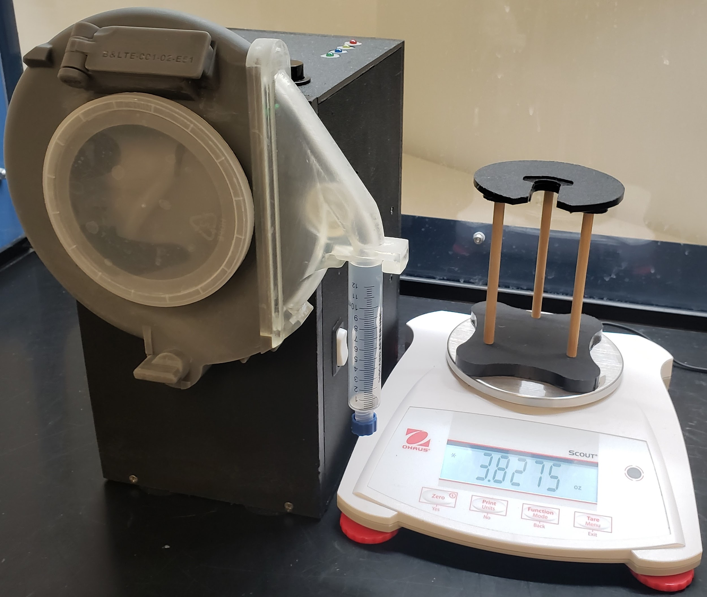
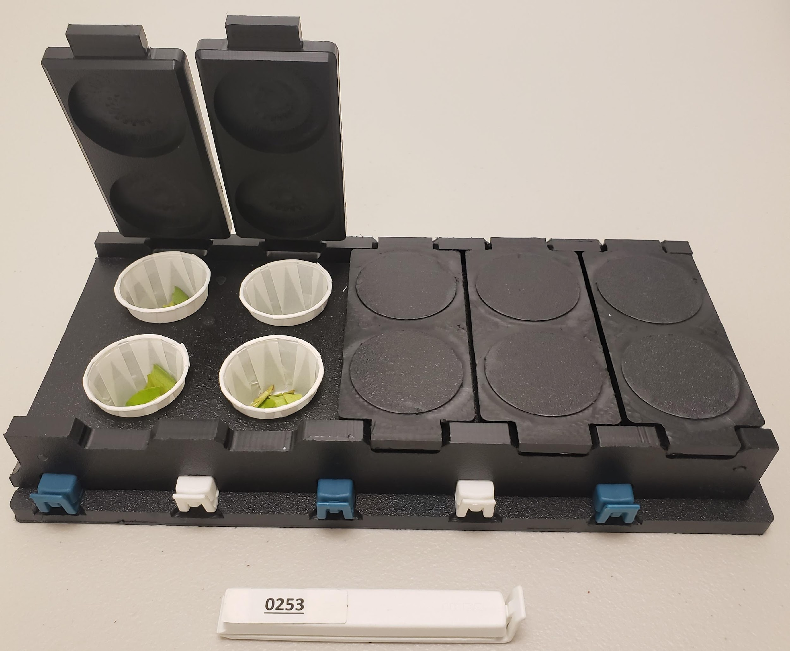
AUTOMATING THE BULK
PROCESSING OF PLANT MATERIAL
(LEAVES, PEDUNCLES, BUDWOOD, AND ROOTS)
2.4 grams of plant material processed in minutes per sample
Hand chopping requires an order of magnitude more time
NFC Tag
Removes the hand-chopping and freeze-drying operation

Slide 6
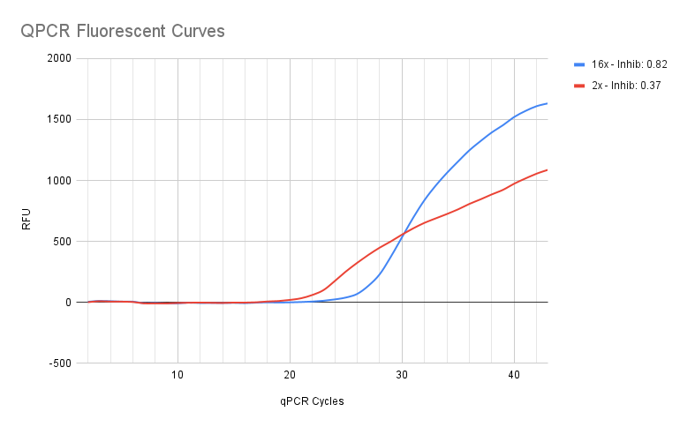
Bulk Process for HLB
What is a bulk sample for Nursery
Bulk samples consist of 16 petioles per tree and 8 trees/sample
  ~2.4 grams of plant material
How to measure qPCR inhibition
Power = Rate of change of the slope
Ratio Aaea over and under the curve
2 Cq shift from 2X to 8X
Maintain DNA Tested/Tree
2. Control and Monitor qPCR inhibition
Measure COX gene expression:
UCR – 0.25g per 1 tree
  Avg COX Cq value of 15.8
TES Needs – 2.0g per 8 trees
  Avg COX Cq value of 12.8 or better
Not Inhibited
Inhibited
8 times the material

Slide 7
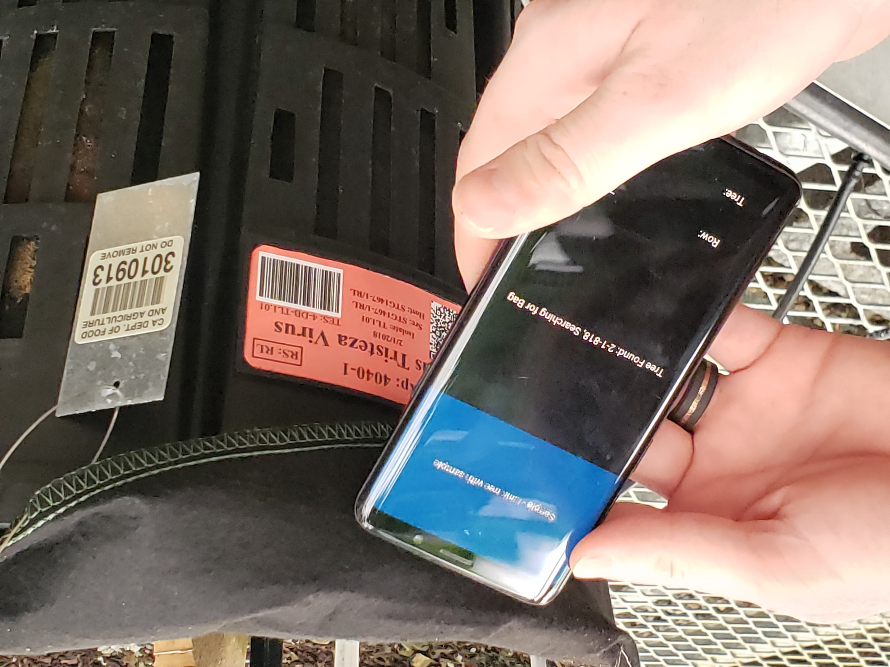
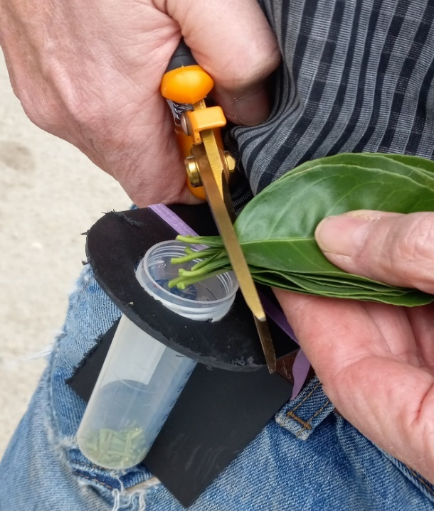
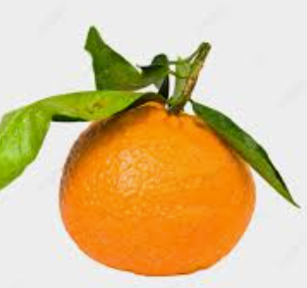
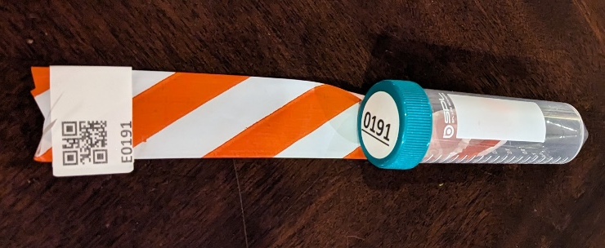
Collection and Paperless Sample Tracking Software
Paperless Sample Tracking
Cut Petioles
Cut Peduncle
Too Large
Collection – Petiole, Budwood, Peduncle, and Roots

Slide 8
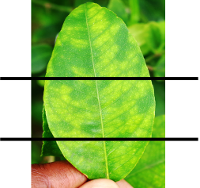
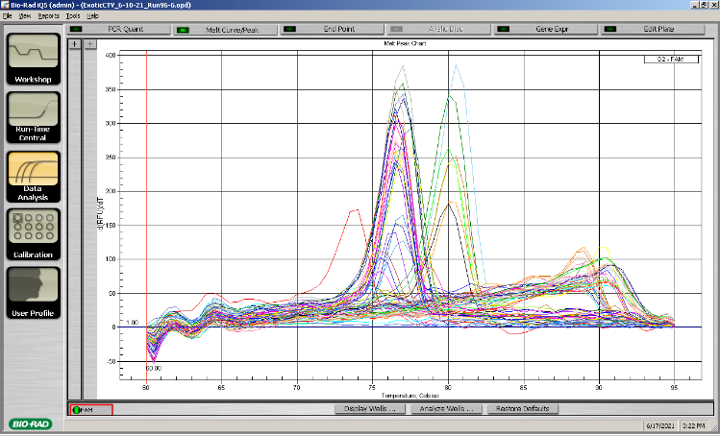
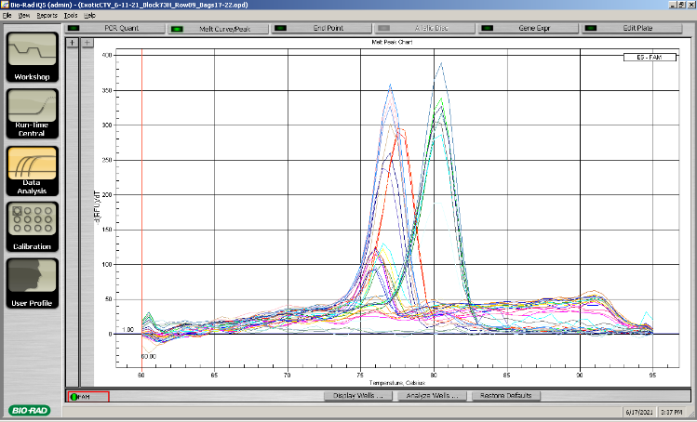
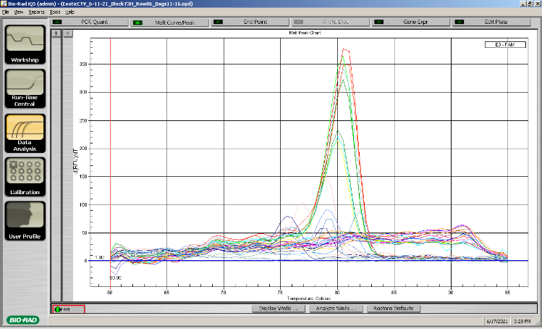
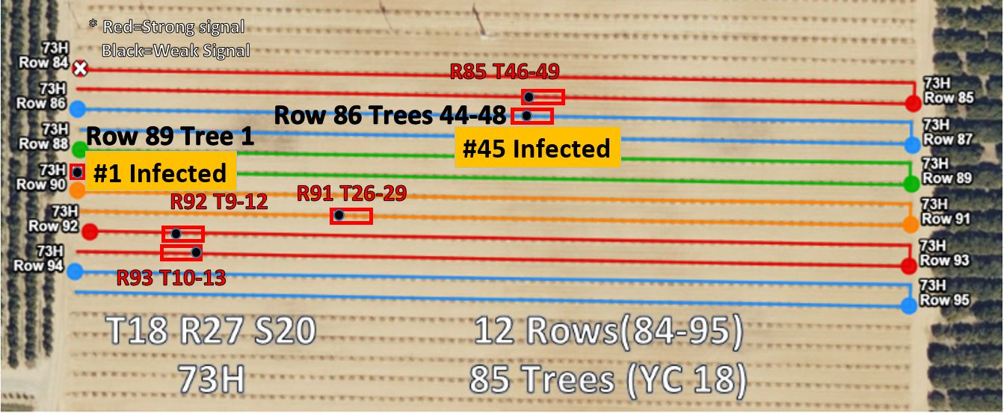
Case Study in Tulare - Hierarchal Bulk Screening
Block has 48 Bulk Samples = 1019 Trees
Work done in Collaboration with Dr.Subhas Hajeri, Operations Manager for Central California Tristeza Eradication Agency (CCTEA)
350,000Trees
Row 89, 6 samples = 21 Trees
Row 86, 6 samples = 24 Trees
2X,10X Diluted
Control
Control
10X Diluted
2 Bulk
10X Diluted
Control
Sample
Samples
Sample
Bulk Screening
Works!
Block 73H Row 86 and Row 89
Case study Tulare 2021
5691 trees
271 bulk tests
9 Total CTV+ Positives
6 CTV+ positive in 73H
SYBR Works
21 trees/bulk
Finding Exotic CTV

Slide 9
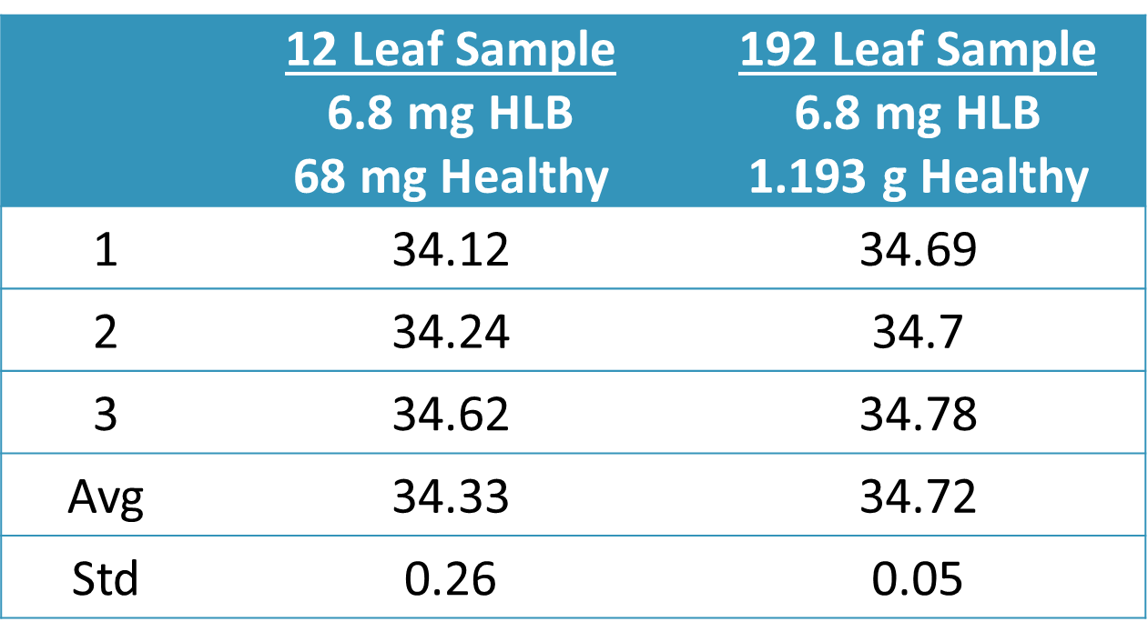
12 LEAVES VS 192 LEAVES (12x16)
Simulate low infection
Table: An aliquot of 6.8mg of previously extracted HLB was added to 12 leaf samples and bulk samples. This data shows that a weak HLB signal does not drop out in the presence of healthy plant material.
No Loss
1 Infected Tree
1 Infected Tree and 15 Healthy Trees

Slide 10
CDFA SINGLE VS TES BULK SAMPLE
32 Tree Bulk
 | CDFA 75mg HLB | TES 75mg HLB | TES 37.5mg HLB + 1.1625g Healthy
1 | 24.63 | 24.85 ± 0.61 | 25.33 ± 0.25
2 | 26.24 | - | 26.31 ± 0.76
Avg | 25.44 | 24.85 | 25.82
Std | 1.14 | 0.61 | 0.69
Table: CDFA provided TES with lyophilized HLB material. TES processes samples using a bulk extraction method while CDFA samples are processed using standard protocol. In a final experiment, TES added half as much material to 31x more material and the matched CDFA process. (n=2)
CDFA 1 Infected Tree
TES 1 Infected Tree
½ Infected Tree Plus 31.5 Uninfected

Slide 11
California Citrus Nursery Board Grant Setup
Systems Approach in Integrating new Pathogens into our Process

Slide 12
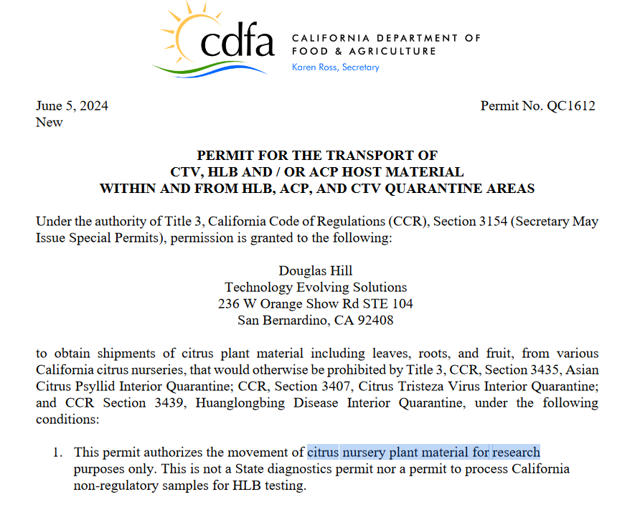
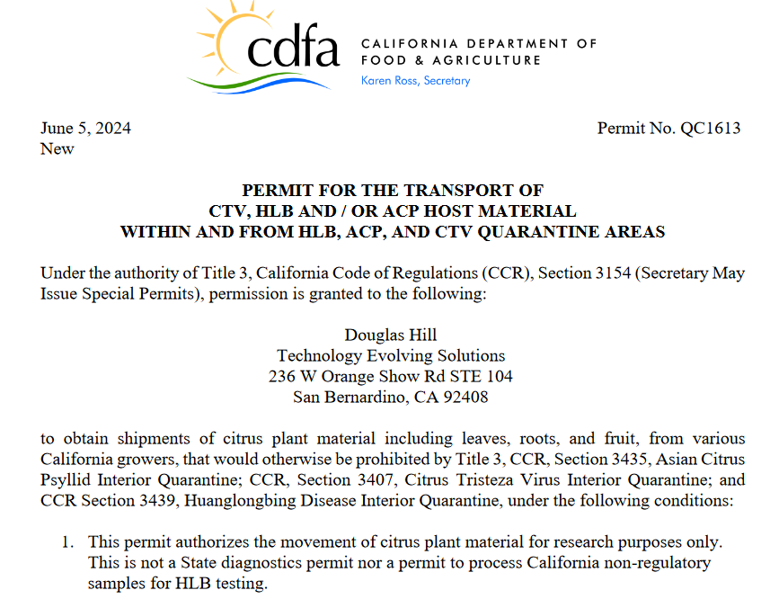
Permits

Slide 13
Target Pathogens, Probe and Primer Sets and Controls
 | Pathogen | Abbreviation | Group | Age | Control | Probe
1 | Citrus Exocortis Viroid | CEVd | NON-APSCA | OLD | Need | X
2 | Citrus Bark Cracking Viroid | CBCVd IV | NON-APSCA | OLD | X | X
3 | Hop Stunt Viroid | HSVd II | NON-APSCA | OLD | X | X
4 | Citrus leaf blotch virus | CLBV | Multiplex | OLD | X | X
5 | Citrus psorosis virus | CPsV | Multiplex | OLD | X | X
6 | Citrus Tristeza Virus | CTV - General | Multiplex | OLD | X | X
7 | Citrus Greening Disease (Hunglongbing) | HLB |  | OLD | X | X
8 | Spiroplasma Citri | S. Citri |  | NEW | X | X
9 | Citrus Tatter Leaf Virus | CTLV |  | NEW | X | X
10 | Yellow Vein Clearing Virus | CYVCV |  | NEW | X | X
11 | Citrus Virus A | CiVA |  | NEW | X | X
12 | Vein enation | CVEV |  | NEW | X | X
1 | Citrus bent leaf viroid | CBLVd I | APSCA | OLD | X | SYBR
2 | Citrus dwarfing viroid | CDVd III | APSCA | OLD | X | SYBR
3 | Citrus viroid V | CVd V | APSCA | OLD | X | SYBR
4 | Citrus viroid VI | CVd VI | APSCA | OLD | X | SYBR
5 | Citrus viroid VII Australia only do not need | CVd VII | APSCA | OLD | Need | SYBR
17 Target Pathogens
12 Currently Tested Pathogens
5 Additional New Pathogens
Control DNA for Pathogens
Probes and Primers for Pathogens
Primary Difference Process Targets:
RNA vs DNA
Reverse transcriptase

Slide 14
Evaluating Controls and Multiplexing
Start with UCR-supplied material
Pathogens:
  16 Pathogens
  5 New Pathogens
  New Pathogens are endemic in California
Groups:
  Non-APSCA
  Multiplex
  APSCA
  Other
Problem:
  Well to well cross-talk with VIC and FAM
  Order all FAM probes
 | Pathogen | Abbreviation | Group | Age | Control | Ct
1 | Citrus Exocortis Viroid | CEVd | NON-APSCA | OLD | Need
2 | Citrus Bark Cracking Viroid | CBCVd IV | NON-APSCA | OLD | X
3 | Hop Stunt Viroid | HSVd II | NON-APSCA | OLD | X | 23.89
4 | Citrus leaf blotch virus | CLBV | Multiplex | OLD | X
5 | Citrus psorosis virus | CPsV | Multiplex | OLD | X | 20.32
6 | Citrus Tristeza Virus | CTV - General | Multiplex | OLD | X | 17.46 TES
7 | Citrus Greening Disease (Hunglongbing) | HLB | Other | OLD | X | 25.3 TES
8 | Spiroplasma Citri | S. Citri | Other | NEW | X | 26.91
9 | Citrus Tatter Leaf Virus | CTLV | Other | NEW | X | 24.18
10 | Yellow Vein Clearing Virus | CYVCV | Other | NEW | X | 24.63
11 | Citrus Virus A | CiVA | Other | NEW | X | 27.35
12 | Vein enation | CVEV | Other | NEW | X | 22.01
1 | Citrus bent leaf viroid | CBLVd I | APSCA | OLD | X | 20.37
2 | Citrus dwarfing viroid | CDVd III | APSCA | OLD | X
3 | Citrus viroid V | CVd V | APSCA | OLD | X
4 | Citrus viroid VI | CVd VI | APSCA | OLD | X
5 | Citrus viroid VII Australia only do not need | CVd VII | APSCA | OLD | Skip

Slide 15
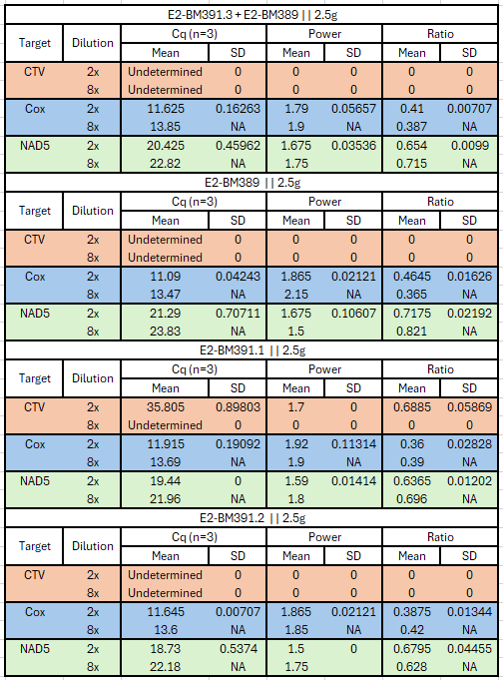
Negative Control For Citrus Material
Search for Negative Control For Citrus Material:
Local Citrus – No Good/Pathogen
  Vein enation CVEV: 29.3
  COX: 18
UCR AgOps Block 7B sample – No Good
  NonAspca: ~24 Cq
  Vein enation CVEV: ~23Cq
  Cox ~ 14.8
Contacted CCNB for Nursery Healthy Material
  Put Nursery Trees in the Database
  Test Vial and tracking method of collection
  Integration into nursery operations
  Optain Healthy material
Healthy Stock – UCR Rubidoux greenhouse
  Screen stock starting with CT
35.05 Ct CTV Cross-contamination

Slide 16
Lab preparation – Swab Testing
Location | 8/26/2024 |  | 8/29/2024 | 9/3/2024 | 9/6/2024
 | HSV | CVEV | CTV | CTV | CTV
Lab1 FumeHood | - | - | 36.73 | - | -
Lab1Prep | - | - | 37.77 | - | -
Lab1Etoh | - | - | - | - | -
Lab1Work | NT | NT | NT | 37.91 | -
Lab1CleanTable | NT | NT | NT | - | NT
Lab1Freezer | NT | NT | NT | 30.12 | -
Lab2Fume | - | - | 37.96 | 34.68 | -
Lab2Prep | - | - | 38.13 | - | -
Lab2Box | NT | NT | NT | NT | -
Lab2LamHood | NT | NT | NT | NT | -
Lab2Computer | - | - | - | NT | -
Lab2-ShreddedSyringes | NT | NT | NT | NT | 31.75
freezerPrep | - | - | - | NT | NT
freezerDoor | - | - | - | NT | NT
Ice Chests | NT | NT | NT | - | NT
PcrTable | - | - | - | NT | NT
doorHandles | - | - | 37.96 | - | 38.01
RyanDesk | - | - | 35.82 | - | -
Lunch Table | NT | NT | NT | - | NT
ExtractPrep | - | - | - | NT | NT
TRIS HCL | NT | NT | - | NT | NT
Chamber Rinse H20 | NT | NT | NT | 37.57 | -
NT=Not Tested - = Negative
Lab actively running samples for HLB
Initial swab test Non-APSCA and Vein enation - Negative
CTV more common
UV and bleach surfaces
Adjust protocol to bleach syringes after processing
Establish a separate nursery extraction station

Slide 17
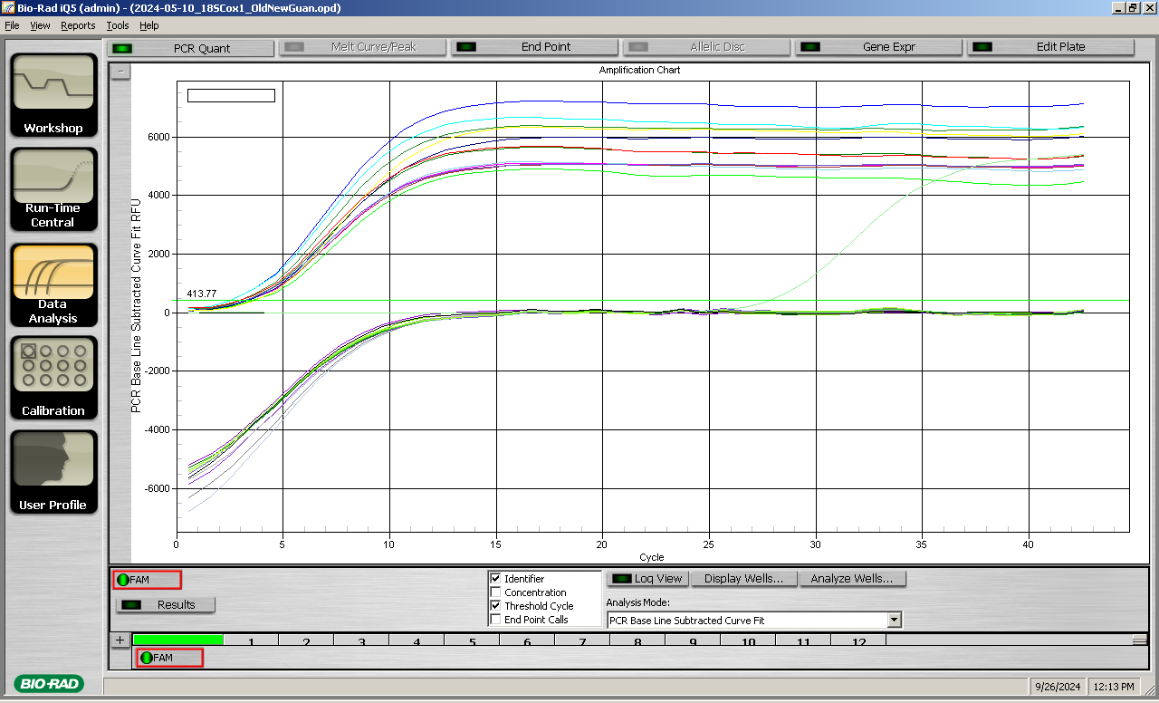
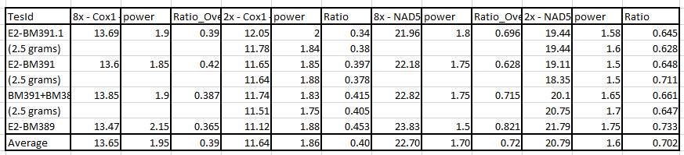
Establishing RNA negative Control
RNA is less stable than DNA, so having a NAD Negative Control ensures a better process
SYBR NAD RNA
  Non-specific binding
  Dilutions, not linear
18S RNA (Dr. Fatima Osman)
  1.2 Gram Sample – Amplifies immediately
  Limit Reverse Transcriptase
  RNA Inhibition from too much RNA – Not a Problem
NAD Probe
  Values Good
  2X to 8X shift = 2.01 Cox
  2X to 8X shift = 1.91 NAD
8X -1.2 Gram 18S Bulk Sample Ct=3
2X -1.2 Gram 18S Bulk Sample Ct=?

Slide 18
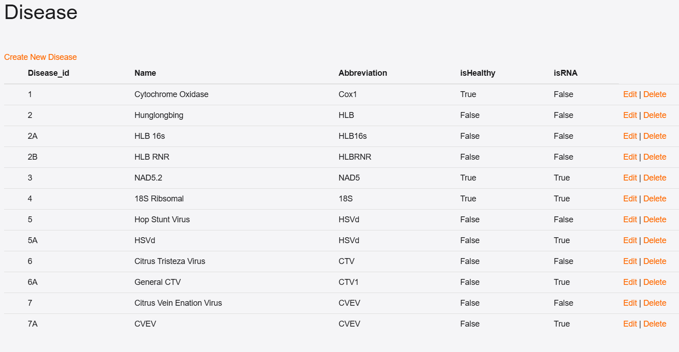
Upgrade Database Software for Pathogens

Slide 19
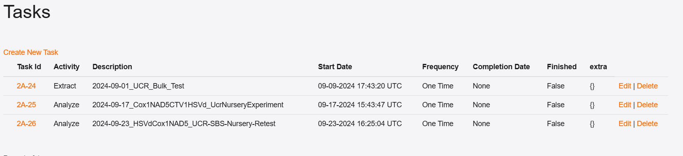
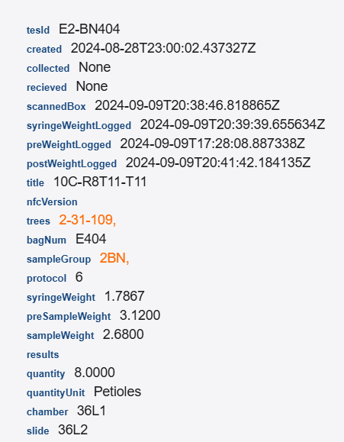
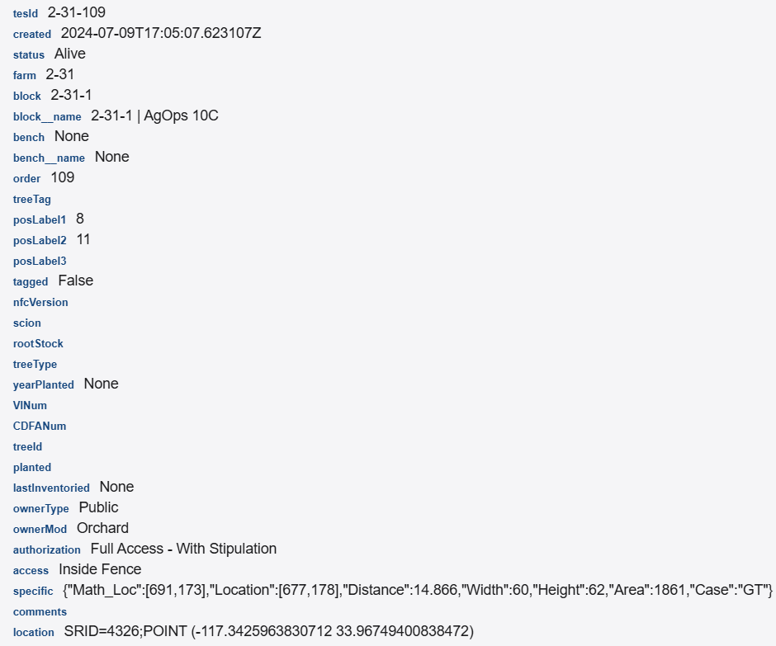
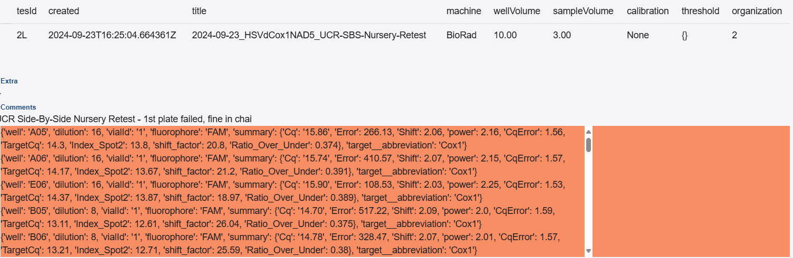
Upgrade Database Software for Pathogens
Tasks
Tasks:
Collect Material
Log in at TES
Extract
Analyze
Lower Administrative Costs
Trees:
Farm
Greenhouse
Scion
Root Stock
Tree type
CDFA Number
Location
GPS
Results:
qPCR
Post Process
Sample:
TES ID
Trees
Weight
Petioles

Slide 20
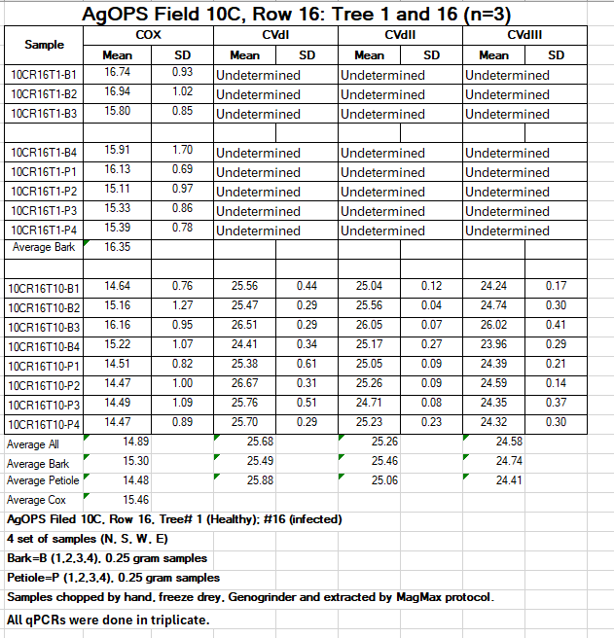
Study of Citrus Tissue
What is the best phloem-rich tissue?
CVdI 25.49 vs 25.88 Bark 0.39 Ct
CVdII 25.46 vs 25.06 Petiole 0.40 Ct
CVdIII 24.74 vs 24.41 Petiole .33 Ct
TES Shifting to Petioles over budwood
Georgios is working on a complex study of tissue types

Slide 21
Validation of Bulk Processing with Nursery Pathogens
Can we maintain sensitivity with bulk processing?

Slide 22
Non-APSCA(HSV)
Citrus Exocortis Viroid, Citrus Bark Cracking Viroid, and Hop Stunt Viroid
As one simulates an infected citrus tree with dilutions ranging from 2^2x to 2^14x of positive control in a group of healthy trees ranging from 1 tree to 20 trees, we see no loss in sensitivity (2^14 = 16,384 dilution). 1.2 gram sample is standard.
Cq is flat across a range of bulk samples showing no loss in sensitivity

Slide 23
APSCA SYBR - Green
Citrus bent leaf viroid, Citrus dwarfing viroid, Citrus viroid V, and Citrus viroid VI
 | Pathogen | Abbreviation | Group | Ct | Peak | Area
1 | Citrus bent leaf viroid | CBLVd I | APSCA | 21.36 | 71.5 | 73.9
 |  |  |  |  | 86.5 | 358.49
 |  |  |  |  | 89.5 | 607.06
2 | Citrus bent leaf viroid | CDVd I | APSCA | 19.86 | 72 | 94.97
 |  |  |  |  | 86 | 309.38
 |  |  |  |  | 89 | 863.98
3 | Citrus bent leaf viroid | CDVd I | APSCA | 19.89 | 71.5 | 103.92
 |  |  |  |  | 79 | 134.24
 |  |  |  |  | 86 | 366.62
 |  |  |  |  | 89 | 984.7
APSCA
Industry using SYBR Green on Viroids to allow multiple pathogens to be combined.
SYBR has a problem with false binding with Bulk Processing
Larger bulk samples showed the problem
Solution is to move to probes

Slide 24
Investigating larger bulk sample weights
Move to 2.8 Gram samples for more sensitivity
 | Weight | 8x - Cox1 - Probe | Power | Ratio_Over_Under | 2x - Cox1 - Probe | power | Ratio_Over_Under | Difference | 1x - Cox1 - Probe | power | Ratio_Over_Under | Difference
 | 2.8g | 13.68 | 2 | 0.411 | 11.62 | 2.02 | 0.431 | 2.02 | 10.3 | 2.03 | 0.565 | 0.985
 |  | 13.21 | 2 | 0.408 | 11.23 | 1.95 | 0.43 |  | 10.58 | 1.81 | 0.575
 | 2.4g | 13.67 | 2.07 | 0.422 | 11.59 | 1.95 | 0.418 | 2.305 | 10.63 | 1.84 | 0.435 | 0.84
 |  | 13.86 | 2.17 | 0.415 | 11.33 | 1.9 | 0.398 |  | 10.61 | 1.9 | 0.452
 | 2.0g | 14.27 | 2.3 | 0.362 | 12 | 2.05 | 0.377 | 2.095 | 10.93 | 2.04 | 0.418 | 1.08
 |  | 13.99 | 2.15 | 0.424 | 12.07 | 2.17 | 0.365 |  | 10.98 | 2.12 | 0.403
 | 1.8g | 14.09 | 2.17 | 0.381 | 12.5 | 2.05 | 0.349 | 1.87 | 11.31 | 1.89 | 0.37 | 1.14
 |  | 14.25 | 2.2 | 0.385 | 12.1 | 2 | 0.383 |  | 11.01 | 1.9 | 0.425
 | 1.6g | 14.61 | 1.95 | 0.421 | 12.18 | 2 | 0.38 | 2.235 | 11.6 | 2.04 | 0.378 | 0.735
 |  | 14.49 | 2 | 0.39 | 12.45 | 2.1 | 0.374 |  | 11.56 | 2.05 | 0.382
 | 1.2g | 14.99 | 2.19 | 0.417 | 12.67 | 1.97 | 0.396 | 2.13 | 11.94 | 2.02 | 0.378 | 0.855
 |  | 14.76 | 2 | 0.421 | 12.82 | 2 | 0.372 |  | 11.84 | 2.05 | 0.37
COX DNA:
  1.2 gram 2X=12.745 Ct
  2.4 gram 2X =11.46 Ct
  Difference =1.285 Twice DNA
  NDA RNA:
    1.2 gram 2X = 25.845 Ct
    2.4 gram 2X =24.09 Ct
    Difference =1.75 Twice+ RNA
2.8 Gram Sample Cox Inhibition:
  1X Power 1.92
  8X to 2X Cox 2.02
  2X to 1X Cox .985
  1X Over/Under Ratio 0.57 vs 0.40
2.8 Gram Sample NAD Inhibition:
  1X Power 1.40
  8x to 2X NAD 2.05
  2X to 1X NAD .96
  1X Over/Under Ratio 0.80 vs 0.77
Weight | 8x - NAD5 - Probe | Power | Ratio_Over_Under | 2x - NAD5 - Probe | Power | Ratio_Over_Under | Difference | 1x - NAD5 - Probe | Power | Ratio_Over_Under | Difference
2.8g | 25.79 | 1.45 | 0.797 | 23.34 | 1.35 | 0.741 | 2.05 | 22.51 | 1.38 | 0.751 | 0.96
 | 25.38 | 1.4 | 0.788 | 23.73 | 1.38 | 0.748 |  | 22.64 | 1.45 | 0.849
2.4g | 27.1 | 1.8 | 0.637 | 24.56 | 1.5 | 0.7 | 2.375 | 22.65 | 1.48 | 0.744 | 0.74
 | 25.84 | 1.45 | 0.86 | 23.63 | 1.33 | 0.754 |  | 24.06 | 1.7 | 0.69
2.0g | 28.28 | 2.25 | 0.624 | 25.28 | 1.75 | 0.638 | 2.95 | 23.27 | 1.5 | 0.684 | 2.14
 | 28.02 | 2.25 | 0.699 | 25.12 | 1.6 | 0.629 |  | 22.85 | 1.45 | 0.79
1.8g | 27.77 | 1.95 | 0.686 | 24.56 | 1.7 | 0.801 | 3.18 | 23.74 | 1.6 | 0.717 | 1.035
 | 28.12 | 2.1 | 0.613 | 24.97 | 1.53 | 0.757 |  | 23.72 | 1.4 | 0.698
1.6g | 9.34 | 1.42 | 2.373 | 23.51 | 1.4 | 0.824 | -6.71 | 23.83 | 1.5 | 0.744 | 0.255
 | 26.25 | 1.7 | 0.816 | 25.5 | 1.7 | 0.697 |  | 24.67 | 1.85 | 0.676
1.2g | 27.9 | 1.7 | 0.782 | 26.37 | 2.1 | 0.598 | 2.215 | 24.42 | 1.4 | 0.667 | 1.775
 | 28.22 | 1.7 | 0.685 | 25.32 | 1.63 | 0.709 |  | 23.72 | 1.38 | 0.766

Slide 25
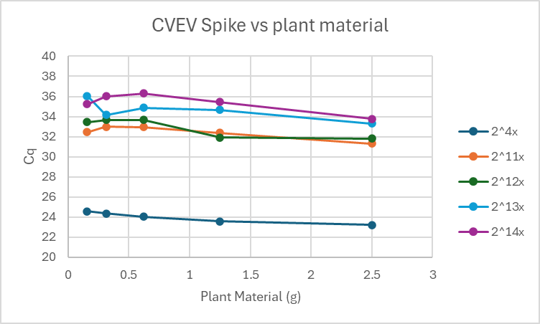
Vein enation
(CVEV)
As you simulate one infected citrus tree with dilutions ranging from 2^4x to 2^14x of positive control in a group of healthy trees ranging from 1 tree to 20 trees, we see no loss in sensitivity (2^14 = 16,384 dilution).
Cq is flat across a range of bulk samples showing no loss in sensitivity

Slide 26
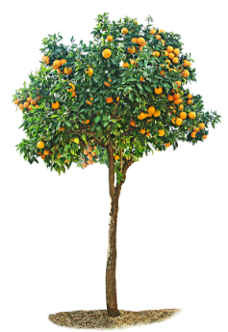
UCR/TES Experimental Setup
Triple Inoculated Citrus Tree
192 Petioles/Bulk
16 Trees/Bulk
North
Set 1 (Bag1)
  North 12 Leaves per side + 1 budwood (use leaves from budwood)
  East 12 Leaves per side + 1 budwood (use leaves from budwood)
  South 12 Leaves per side + 1 budwood (use leaves from budwood)
  West 12 Leaves per side + 1 budwood (use leaves from budwood)
  Total 48 Leaves + 4 Budwood
  0.25 Petiole (P1) and Budwood (B1) Sample
Set 2 (Bag2)
  North 12 Leaves per side + 1 budwood (use leaves from budwood)
  East 12 Leaves per side + 1 budwood (use leaves from budwood)
  South 12 Leaves per side + 1 budwood (use leaves from budwood)
  West 12 Leaves per side + 1 budwood (use leaves from budwood)
  Total 48 Leaves + 4 Budwood
  0.25 Petiole (P2) and Budwood (B2) Sample
Set 3 (Bag3)
  North 12 Leaves per side + 1 budwood (use leaves from budwood)
  East 12 Leaves per side + 1 budwood (use leaves from budwood)
  South 12 Leaves per side + 1 budwood (use leaves from budwood)
  West 12 Leaves per side + 1 budwood (use leaves from budwood)
  Total 48 Leaves + 4 Budwood
  0.25 Petiole (P3) and Budwood (B3) Sample
Set 4 (Bag4)
  North 12 Leaves per side + 1 budwood (use leaves from budwood)
  East 12 Leaves per side + 1 budwood (use leaves from budwood)
  South 12 Leaves per side + 1 budwood (use leaves from budwood)
  West 12 Leaves per side + 1 budwood (use leaves from budwood)
  Total 48 Leaves + 4 Budwood
  0.25 Petiole (P4) and Budwood (B4) Sample
2 Gram Bulk Sample
West
East
South
Healthy Citrus Tree = 1 Bulk Sample
North
West
East
South
Triple Inoculated Citrus Tree = 1 Bulk Sample

Slide 27
UCR – TES Non-APSCA Bulk vs Individual
2^4=16
16.35-11.83=4.52 25.46-20.02=5.44 15.3-11.02 = 4.28
2^5=32X Pathogen RNA
E2-BN403 | 10C-R8T20
Target | Dilution | Cq (n=3) |  | Power |  | Ratio
 |  | Mean | SD | Mean | SD | Mean | SD
HSVd | 1x | Undetermined
 | 2x | Undetermined
 | 8x | Undetermined*
 | 16x | Undetermined
Cox | 1x | 21.14** | 3.54 | 1.41 | 0.12 | 0.65 | 0.07
 | 2x | 11.83 | 0.18 | 2.06 | 0.14 | 0.64 | 0.04
 | 8x | 14.31 | 0.11 | 2.09 | 0.1 | 0.43 | 0
 | 16x | 15.28 | 0.17 | 2.13 | 0.11 | 0.4 | 0.01
NAD5 | 1x | 21.31** | 0.00 | 1.38 | 0.00 | 0.75 | 0.00
 | 2x | 19.07 | 0.44 | 1.82 | 0.26 | 0.77 | 0.02
 | 8x | 23.05 | 0.46 | 1.88 | 0.2 | 0.66 | 0.03
 | 16x | 22.53 | 1.06 | 1.72 | 0.33 | 0.66 | 0
Target | Dilution | Cq (n=3) |  | Power |  | Ratio
 |  | Mean | SD | Mean | SD | Mean | SD
HSVd | 1x | 19.52 | 0.29 | 1.97 | 0.03 | 0.85 | 0.03
 | 2x | 20.02 | 0.09 | 2.28 | 0.08 | 0.69 | 0.04
 | 8x | 22.04 | 0.06 | 2.27 | 0.02 | 0.71 | 0.05
 | 16x | 23.12 | 0.11 | 2.03 | 0.06 | 0.76 | 0.06
Cox | 1x | 18.2 | 2.63 | 1.38 | 0.09 | 0.68 | 0.07
 | 2x | 11.02 | 0.02 | 1.92 | 0.11 | 0.59 | 0.04
 | 8x | 13.1 | 0.06 | 2.02 | 0.03 | 0.38 | 0
 | 16x | 14.28 | 0.1 | 2.19 | 0.06 | 0.38 | 0.01
NAD5 | 1x | 25.01** | 0.88 | 1.64 | 0.14 | 0.71 | 0.01
 | 2x | 19.23 | 0.46 | 1.8 | 0.21 | 0.66 | 0.02
 | 8x | 21.69 | 0.41 | 1.92 | 0.14 | 0.56 | 0.03
 | 16x | 22.35 | 0.3 | 1.62 | 0.06 | 0.61 | 0
* One result, partial rise, not above threshold (i.e. in noise floor), deemed negative
* One result, partial rise, not above threshold (i.e. in noise floor), deemed negative
All qPCR done in triplicate except where noted
1.41,1.38, and 1.64 all show signs of inhibition

Slide 28
UCR – TES APSCA Bulk vs Individual SYBR
APSCA SYBR 25.92 single vs 24.62 Bulk Non-APSCA 22.93 single vs 19.22 Bulk Ct
SYBR is a triage approach to determine cost-effectively if a pathogen may be present.
If a pathogen group is detected then probes are used to determine which pathogen
Bulk processing allows for the probes to be used cost-effectively
TES Cq
 | 403 |  | 404
 | Aspca | NonAspca | Aspca | NonAspca
1x | - | - | - | -
2x | - | - | 31 | -
8x | 33.09* | 32* | 24.62 | 19.22
16x | 32.62* | 32.6* | 25.6 | 17.9
UCR Sample | NAD | Aspca |  | NonAspca
 | Mean | Mean | SD | Mean | SD
10CR16T1-B1 | 22.61 | Undetermined |  | Undetermined
10CR16T1-B2 | 21.26 | Undetermined |  | Undetermined
10CR16T1-B3 | 20.24 | Undetermined |  | Undetermined
10CR16T1-B4 | 20.71 | Undetermined |  | Undetermined
10CR16T1-P1 | 19.49 | Undetermined |  | Undetermined
10CR16T1-P2 | Undetermined | Undetermined |  | 34.76* | 0.01
10CR16T1-P3 | 19.16 | Undetermined |  | Undetermined
10CR16T1-P4 | 19.08 | Undetermined |  | Undetermined
10CR16T16-B1 | 19.65 | 24.65 | 0.50 | 22.14 | 0.08
10CR16T16-B2 | 21.36 | 26.00 | 0.22 | 23.10 | 0.15
10CR16T16-B3 | 21.06 | 28.32 | 0.37 | 24.10 | 0.20
10CR16T16-B4 | 20.00 | 24.71 | 0.40 | 22.41 | 0.30
10CR16T16-P1 | 18.85 | 24.81 | 0.23 | 24.92 | 1.14
10CR16T16-P2 | 18.75 | 26.22 | 0.47 | 25.12 | 0.86
10CR16T16-P3 | 18.61 | 26.23 | 0.56 | 25.29 | 1.13
10CR16T16-P4 | 18.62 | 25.47 | 0.60 | 25.02 | 1.27
Non-specific binding causes false Ct values with bulk processing.
Bulk sample was 2 grams
TES Melt Curve Peaks
 | 403 |  |  |  | 404
 | Apsca (peak @ 86) |  | NonApsca (peak @ 83) |  | Apsca (peak @ 86) |  | NonApsca (peak @ 83)
 | peak dRFU | Area | peak dRFU | Area | peak dRFU | Area | peak dRFU | Area
1x | - | - | - | - | - | - | 75.57 | 241.37
2x | - | - | - | - | 341.76 | 493.94 | 98.42 | 211.90
8x | - | - | - | - | 381.25 | 599.82 | 219.64 | 654.15
16x | - | - | - | - | 525.27 | 1069.88 | 293.99 | 949.23
1X and 2X Dilution have lower peaks due to bulk processing
1X and 2X Dilution have lower areas due to bulk processing

Slide 29
Bulk Processing Cost
Target processing 8 trees at a time

Slide 30
Plate Setup (4 Bulk Samples)
 | 1 | 2 | 3 | 4 | 5 | 6 | 7 | 8 | 9 | 10 | 11 | 12
A | S1 2x CVEV | S1 8x CVEV | S2 2x CVd I, III | S2 8x CVd I, III | S2 2x CVEV | S2 8x CVEV | S3 2x CVEV | S3 8x CVEV | S4 2x CVd I, III | S4 8x CVd I, III | S4 2x CVEV | S4 8x CVEV
B | S1 2x CiVA | S1 8x CiVA | S2 2x CVd V, VI | S2 8x CVd V, VI | S2 2x CiVA | S2 8x CiVA | S3 2x CiVA | S3 8x CiVA | S4 2x CVd V, VI | S4 8x CVd V, VI | S4 2x CiVA | S4 8x CiVA
C | S1 2x CYVCV | S1 8x CYVCV | S2 2x NAD5 | S2 8x NAD5 | S2 2x CYVCV | S2 8x CYVCV | S3 2x CYVCV | S3 8x CYVCV | S4 2x NAD5 | S4 8x NAD5 | S4 2x CYVCV | S4 8x CYVCV
D | S1 2x CTLV | S1 8x CTLV | S2 2x COX | S2 8x COX | S2 2x CTLV | S2 8x CTLV | S3 2x CTLV | S3 8x CTLV | S4 2x COX | S4 8x COX | S4 2x CTLV | S4 8x CTLV
E | S1 2x S. Citri | S1 8x S. Citri | S1 2x COX | S1 8x COX | S2 2x S. Citri | S2 8x S. Citri | S3 2x S. Citri | S3 8x S. Citri | S3 2x COX | S3 8x COX | S4 2x S. Citri | S4 8x S. Citri
F | S1 2x HLB RNR | S1 8x HLB RNR | S1 2x NAD5 | S1 8x NAD5 | S2 2x HLB RNR | S2 8x HLB RNR | S3 2x HLB RNR | S3 8x HLB RNR | S3 2x NAD5 | S3 8x NAD5 | S4 2x HLB RNR | S4 8x HLB RNR
G | S1 2x CTV/CLBV/ CPsV | S1 8x CTV/CLBV/ CPsV | S1 2x CVd V, VI | S1 8x CVd V, VI | S2 2x CTV/CLBV/ CPsV | S2 8x CTV/CLBV/ CPsV | S3 2x CTV/CLBV/ CPsV | S3 8x CTV/CLBV/ CPsV | S3 2x CVd V, VI | S3 8x CVd V, VI | S4 2x CTV/CLBV/ CPsV | S4 8x CTV/CLBV/ CPsV
H | S1 2x NonAspca | S1 8x NonAspca | S1 2x CVd I, III | S1 8x CVd I, III | S2 2x NonAspca | S2 8x NonAspca | S3 2x NonAspca | S3 8x NonAspca | S3 2x CVd I, III | S3 8x CVd I, III | S4 2x NonAspca | S4 8x NonAspca
Setup:
4 Bulk samples per plate
Each sample has 2 healthy controls
  Cox – DNA
  NAD5 – RNA
Each sample has 16 disease targets
  10 of which are multiplexed
Each target (healthy and diseased):
  Two dilutions, 2x and 8x
All disease targets have:
  A positive control
16 Positive Controls for16 Pathogens

Slide 31
Cost Per Mother-Tree Tested
Sample Cost / Tree
Labor | Processing | $ 0.81
 | Extraction | $ 0.59
 | qPCR | $ 6.09
 | Total | $ 7.50
Supplies | Processing | $ 0.04
 | Extraction | $ 0.23
 | qPCR | $ 1.62
 | Other | $ 0.62
 | Total | $ 2.50
Overhead |  | $ 40.00
 | Total | $ 50.00
Assumption:
3000 – 3500 Mother trees
8 Trees per sample
0.3 grams of material tested per tree
Each Mother tree is tested for 16 Pathogens
3 Months for Processing
Collection and shipping are handled by the grower
Paperless sample collection
50% profit included in overhead
Savings:
Assuming the current cost of $130/tree
3000 x $130 = $390,000 vs $150,000*
*Plus CDFA overhead

Slide 32
Triage approach to saving money
Bulk processing is a rapid and cost-effective way to determine which trees are suspect.
If a suspect tree is identified CDFA will confirm.
No false positives
Since almost all trees are not infected, triage is very efficient

Slide 33
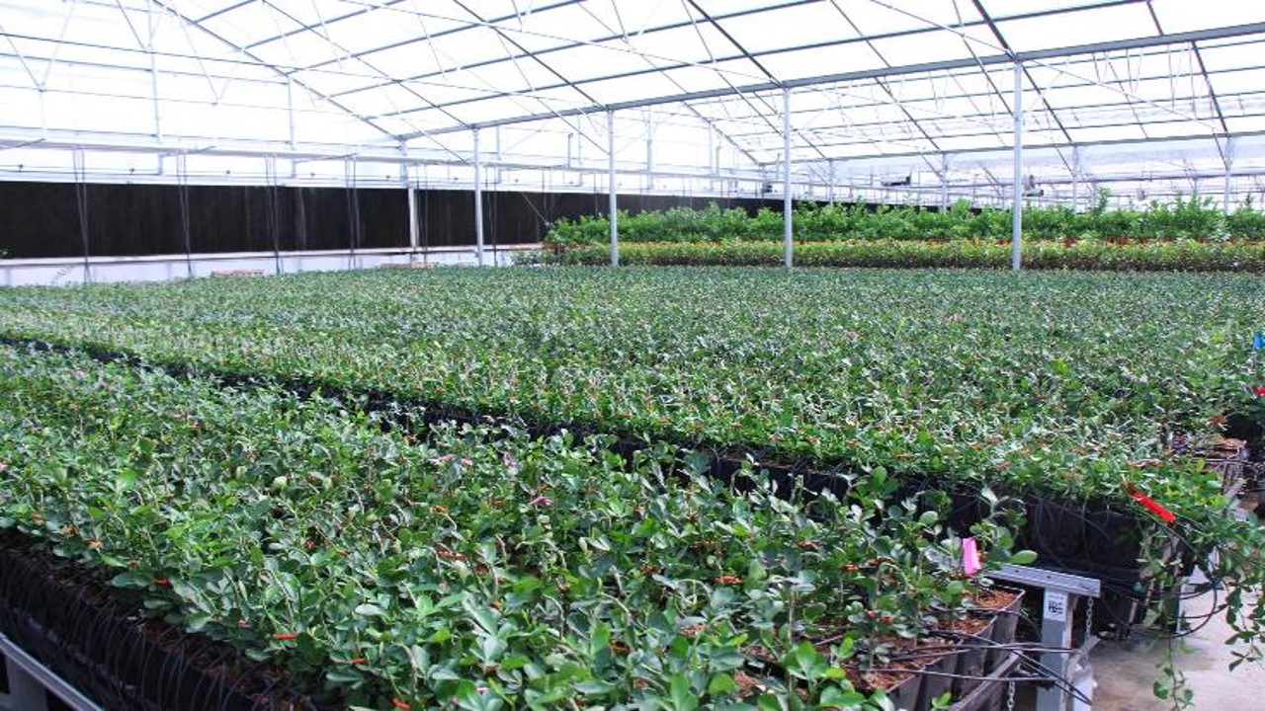
Thank You!
Any Questions?
Dr. Douglas Hill
President of Technology Evolving Solutions
tiggerhill@gmail.com
https://technologyevolvingsolutions.com
236 W. Orange Show Rd., Ste. 104
San Bernardino, CA. 92408
(714) 969-1150 - Cell

Slide 34
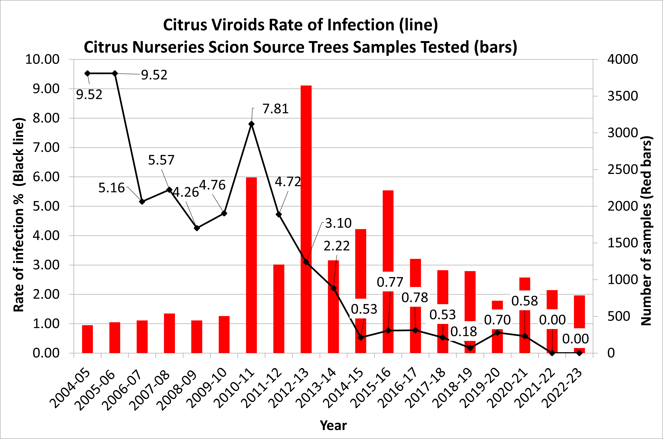
Time – 5 to 12 Years
Mother tree screening
CALIFORNIA CITRUS NURSERY STOCK PEST CLEANLINESS PROGRAM
Bulk screening = Lower costs
Voluntary
Bioindexing
Mandatory
RT-qPCR
Time and Widespread Commitment

Slide 35
Plate Setup 2
CHAI Plate Layout for Positive Controls :
 | 1 | 2 | 3 | 4 | 5 | 6 | 7 | 8
A | Pos 1x CEVd (NonAspca) | Pos 1x CBCVd (NonAspca) | Pos 1x HSVd (NonAspca) | Pos 1x CLBV | Pos 1x CPsV | Pos 1x CTV | Pos 1x HLB | Pos 1x S. Citri
B | Pos 1x CTLV | Pos 1x CYVCV | Pos 1x CiVA | Pos 1x CVEV | Pos 1x CVd I (Aspca) | Pos 1x Cvd III (Aspca) | Pos 1x CVd V (Aspca) | Pos 1x CVd VI (Aspca)
16 Positive Controls for16 Pathogens which provide confidence that if we had a positive we would detect it.

Slide 36
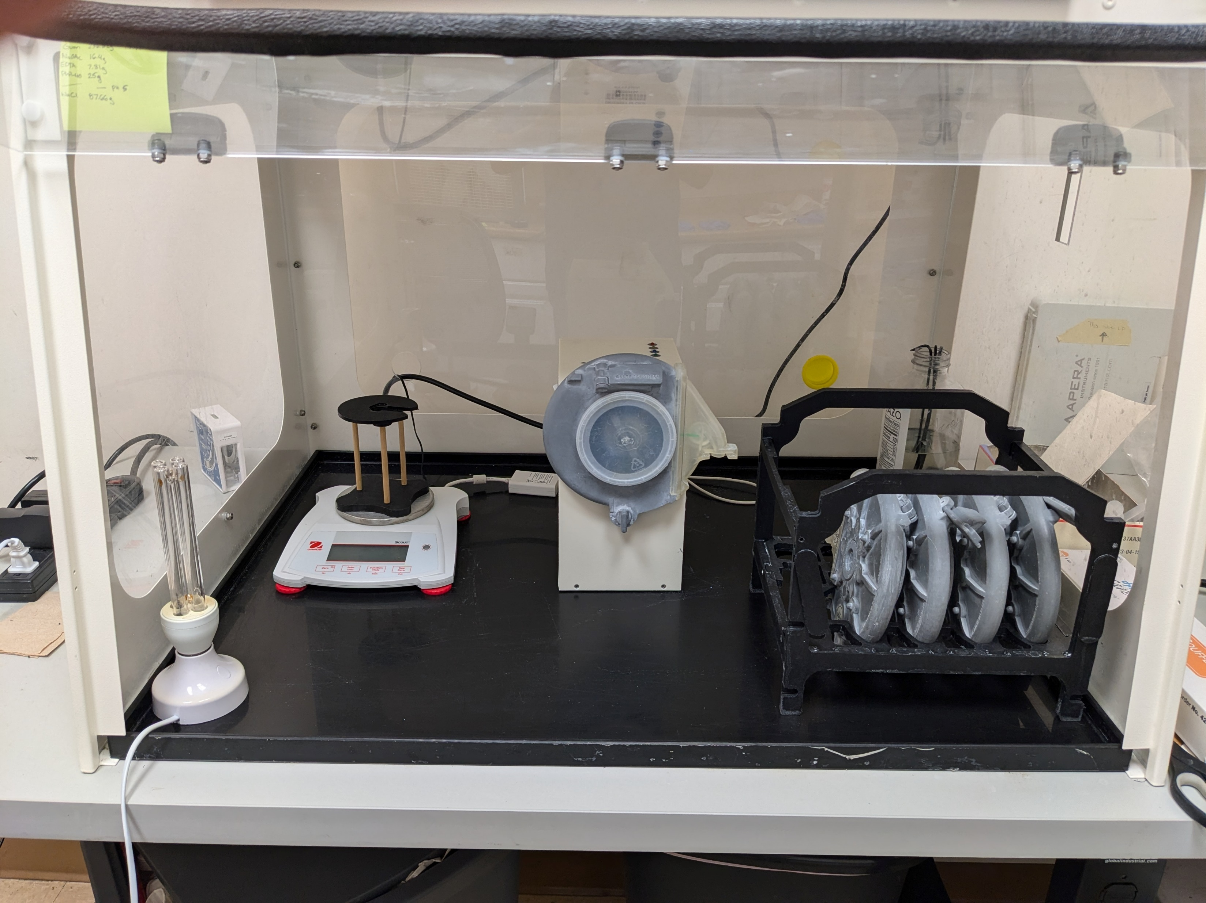
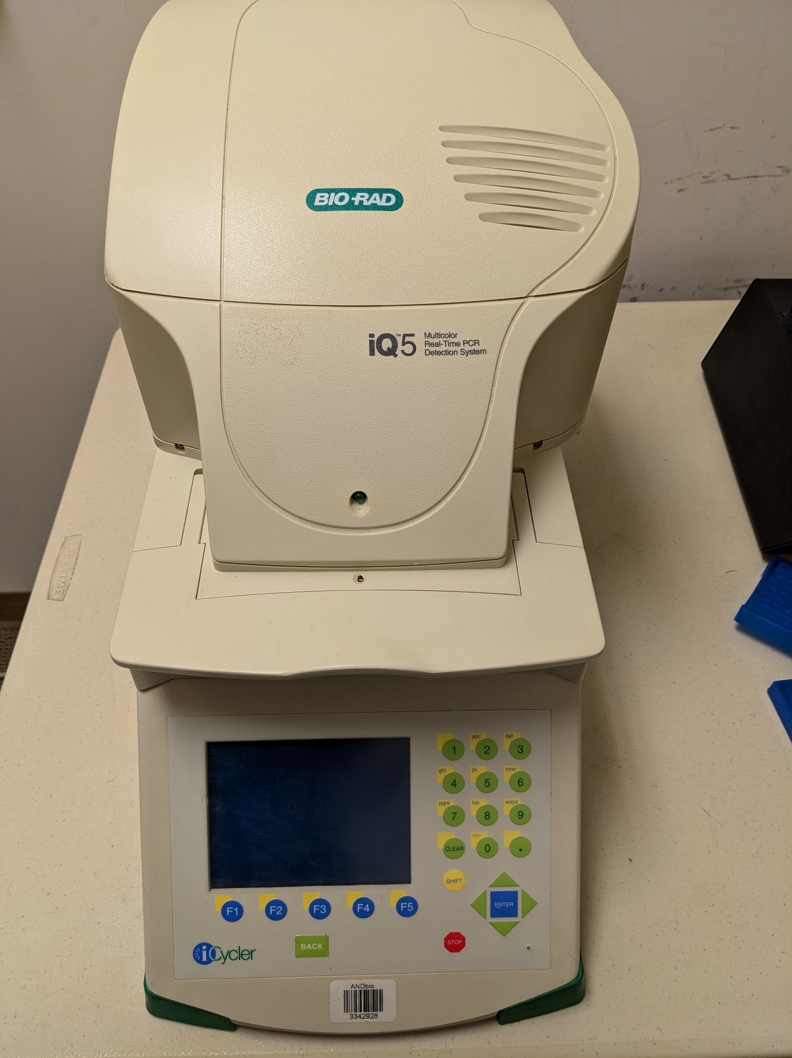
Establish a separate nursery tissue extraction station
Upgrade QPCR Machine

