Slide 1
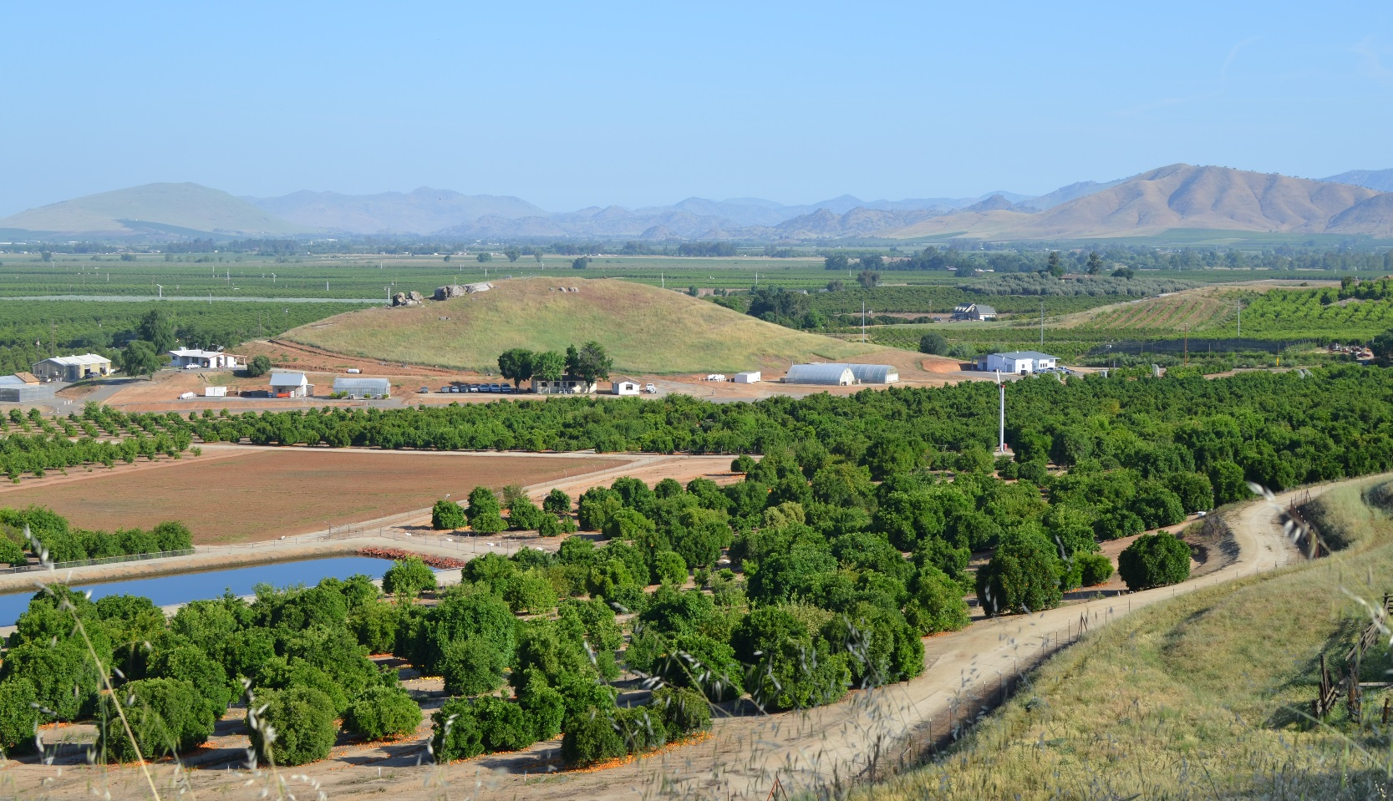

Annual Tristeza Indexing at LREC
Ashraf El-Kereamy
LREC Director, UCANR
Cooperative Extension Specialist
Department of Botany and Plant Sciences, UC Riverside

Slide 2
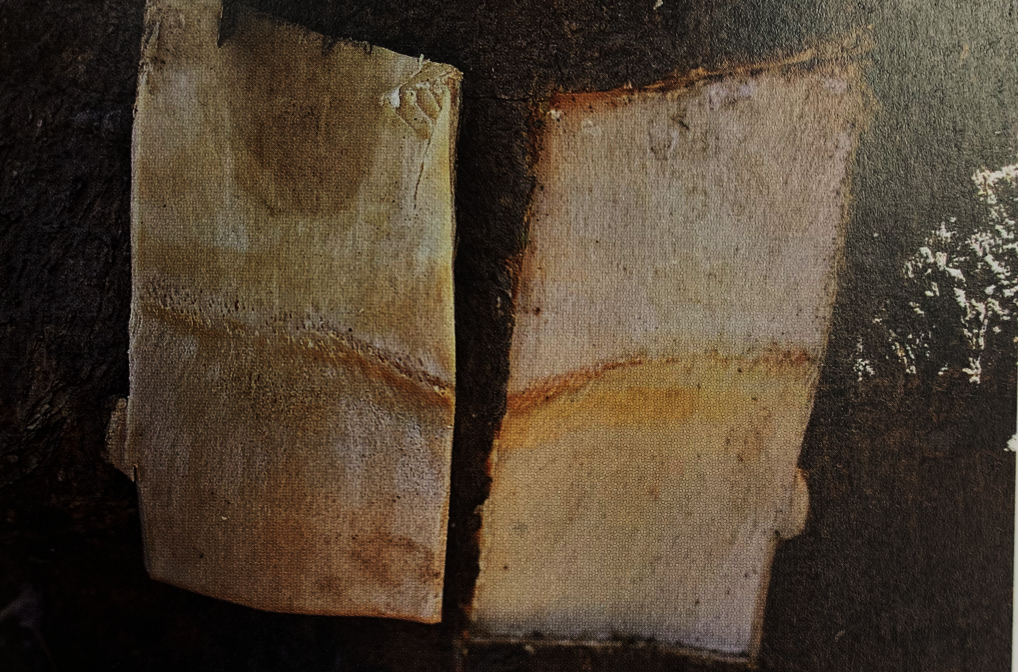
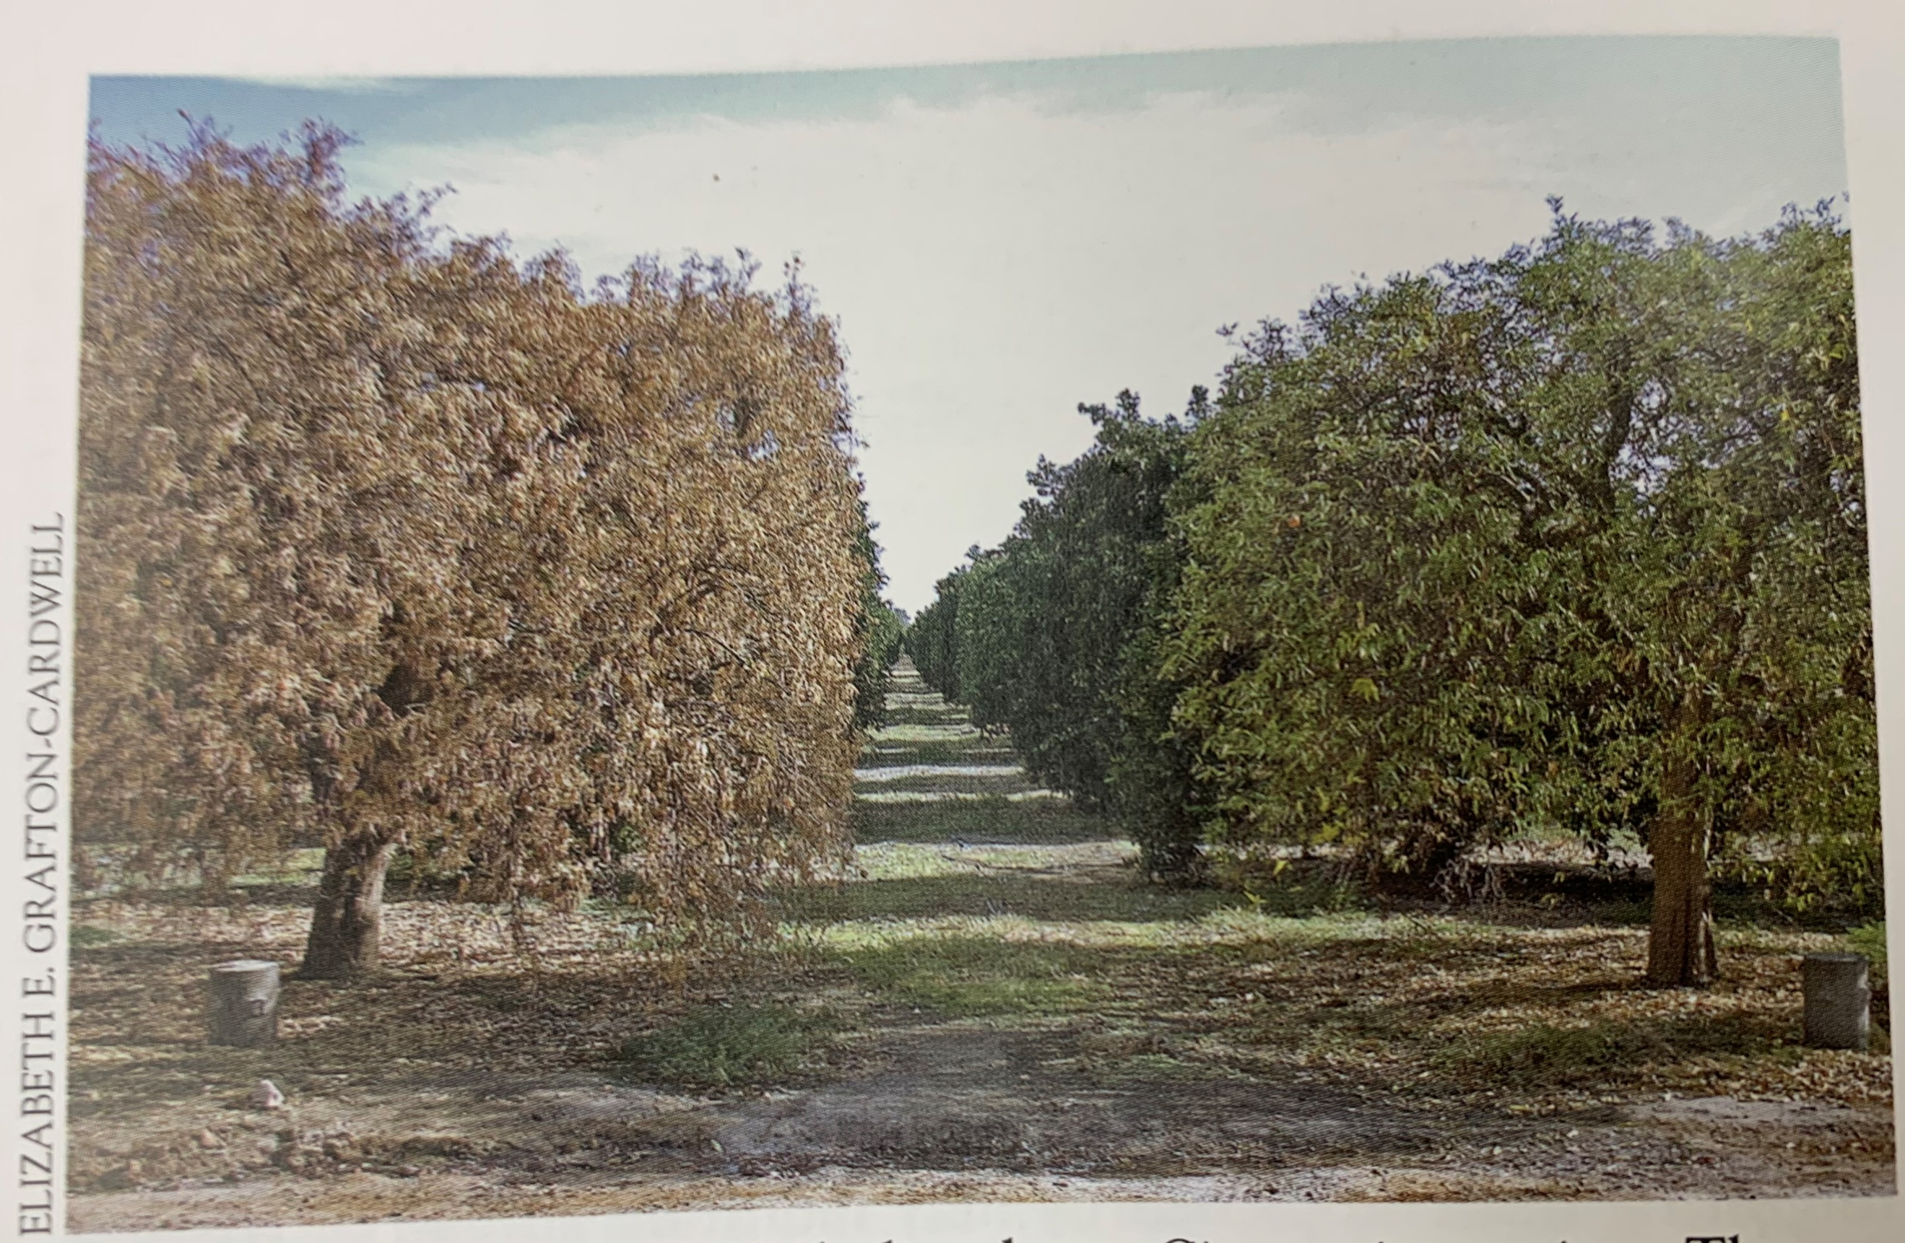
Annual citrus tristeza virus index at the Lindcove Research & Extension Center.
Citrus tristeza virus (CTV) is a viral species of the genus Closterovirus
Tristeza virus is spread through budding and grafting or by aphids feeding on citrus.
Tree decline
We maintain around 300 variety and rootstock
Demonstration orchard
UCR breeding
CCPP

Slide 3
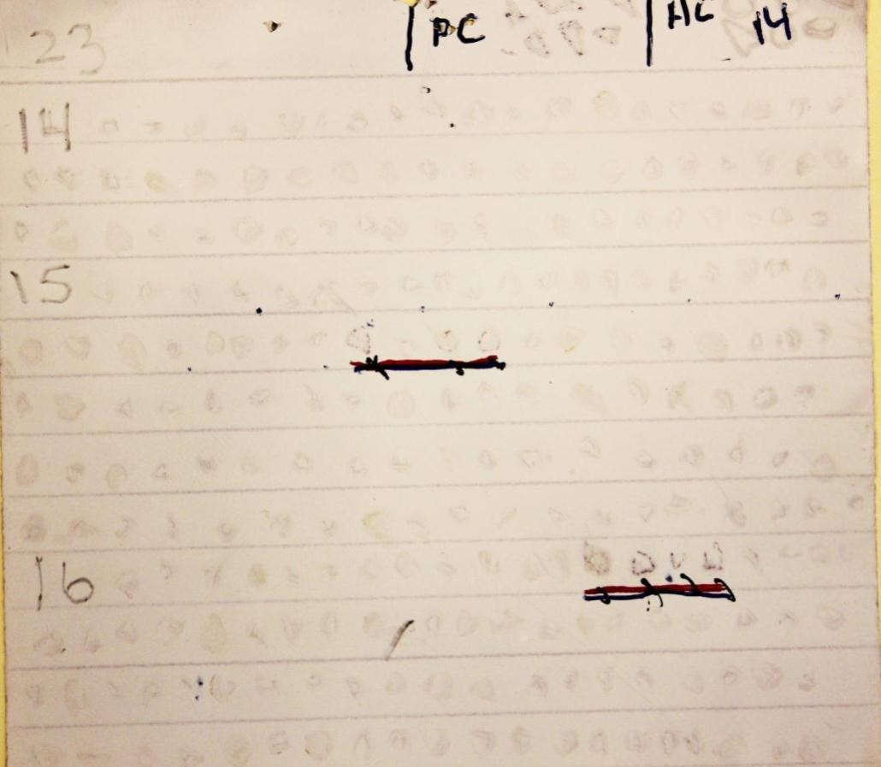
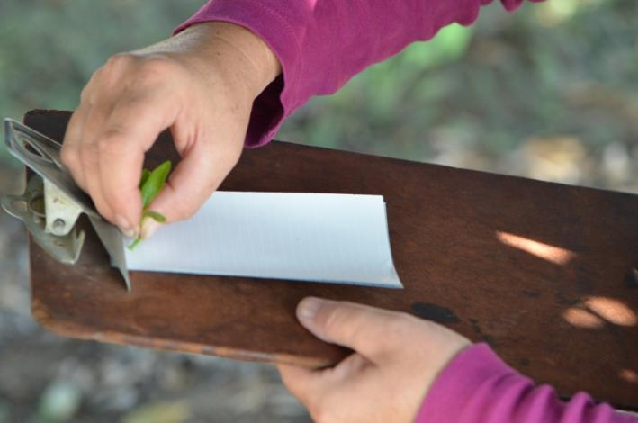
Annual Citrus Tristeza Virus Indexing at Lindcove Research and Extension Center
Block No.
Pos control
Row No.
DTBIA blot
3/4 pos
4/4 pos
In 2023, we tested 11,802 trees with a total of 328 CTV positive trees including 2 MCA-13 positive.

Slide 4
Number of CTV-infected trees at the Lindcove Research and Extension Center
Collection in April-May

Slide 5
Lindcove Research & Extension Center
Conference
Facility
F 63E
North
CTV Results April-June 2024 AFrolli
IR4
CCTEA confirmed CTV POSITIVES 2024 (379 MILD)
NO MCA13 POSITIVES
12,040 trees tested
F64E
F63W
4
F50
F55
F64C
F56
F66
1
F64W
1
7
3
F71
4
F72
5
Reservoir
81E
F53E
F52E
1
81C
New Lab
GH
F51
3
F53C
F82E
13
MR
P55
F73N
F73S
F81W
Dormitory
F52W
6
EF
P125
GH
F53W
F82W
F83
Shed
IR4 PRJ - 75
3
14
Residence
F80
22
Carson Ave
Lath
Flying
Dragon 41FD
F41 N
F40
F42
Office
Shop
GH
4
15
4
Packline
4
Reservoir
F31
F15
F21
F22
F23
F24
F91E
F92E
F93
25
F93SE
39
47
1
19
2
F11N
P-75
I
R
4
F11S
F12
F91C
33
19
F92C
15
18
47
F91W
1
Pond
Crop other than citrus
Road 228
F92W

Slide 6
Based of the recommendations of the Aug 2019 committee to evaluate CTV-infected tree removal at Lindcove (B. Grafton-Cardwell, J. Barnier, G. Douhan, S. Hajeri, M. Polek, G. Vidalakis, R. Yokomi, J. Zaninovich)
1. Suspend tree removal of CTV-infected trees at LREC, except for MCA13 reactive (potential severe strain) trees.
2024: No tree found
2. Continue vector control twice yearly in the 1-2 miles commercial and residential citrus around LREC.
3. Continue 100% DTBIA testing of all trees at LREC, with follow up testing of any positive trees via PCR for strain identification.
In 2024 we tested 12040 trees with a total of 379 CTV positive trees including 0 MCA-13 positive

