Slide 1


The effect of seed moisture and storage temperature on the viability of citrus rootstock seeds
David Laughlin, PhD
Texas A&M Kingsville Citrus Center

Slide 2
Justification
Citrus nurseries require a constant supply of rootstock seeds to support new planting and resetting efforts
Seeds are harvested during the few months when fruit are ripe and must be stored throughout the year
Seeds stored for more than several months can lose viability which means that there is period of time before new seed becomes available that there is often a lack of seed
Thus there is a need to develop practices to extend the viability of citrus rootstock seeds

Slide 3
Experimental design
Sour orange
Carrizo
Rubideaux Trifoliate
3 varieties
X
~25 %
~15 %
~10 %
~5 %
4 moisture treatments
X
20 ˚C
68 ˚F
10 ˚C
50 ˚F
4 ˚C
39 ˚F
0 ˚C
32 ˚F
4 temperatures

Slide 4
Seed Drying Methodolgy
A drying chamber inside of a sealed room was developed for controlled drying of seeds
A box with three mesh trays was used the place the seeds which included a variable speed fan attached to the bottom of the box to move air upwards through the seed
The chamber was also equipped with a dehumidifier and a space heater to maintain a temperature of 32 °C (90 °F) and a relative humidity of about 35% (variable)

Slide 5
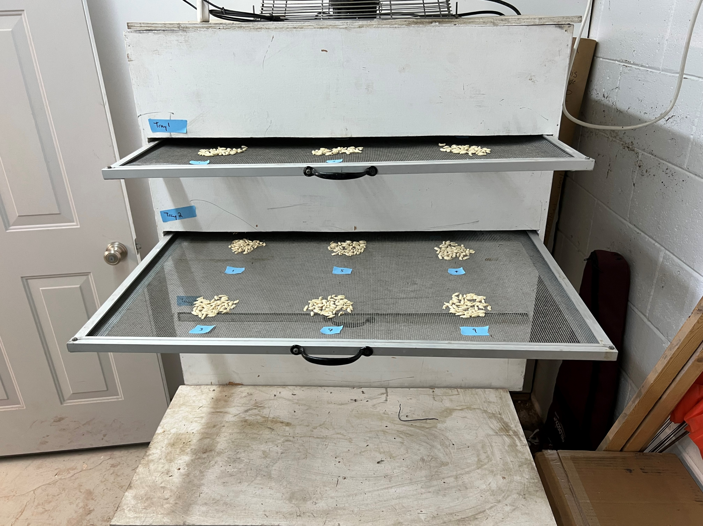

Slide 6
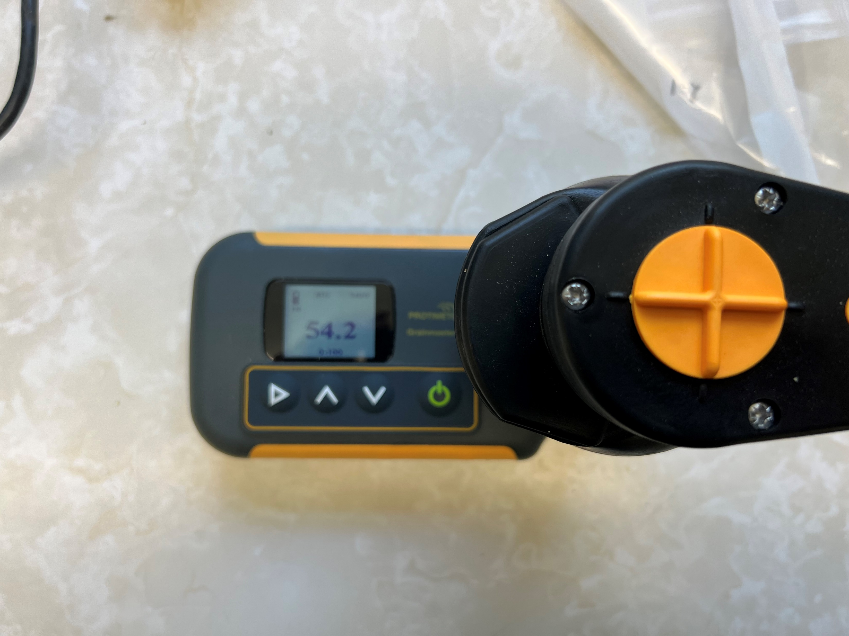
Seed Moisture Evaluation
We attempted to use seed moisture apparatus to correlate % seed moisture with 0-100 value provided by the apparatus
The apparatus was too inconsistent despite multiple attempts so this part of the project was abandoned
Therefore, following each drying event, samples of each batch was collected to determine average % seed moisture per variety and drying treatment
% moisture = ((initial weight-final weight)/initial weight))x100

Slide 7
Temperature Control
To achieve accurate and economical temperature control, we built 4 individual incubators out of small 6.9 cubic feet, Hotpoint brand (Lowes) chest freezers using Dwyer temperature controllers
Incubators were accurate with in 2° C with minimal fluctuation
Freezer cost - $ 189
Controller cost - $ 118
Extension cord - $ 15
Total cost - $ 322 per incubator

Slide 8
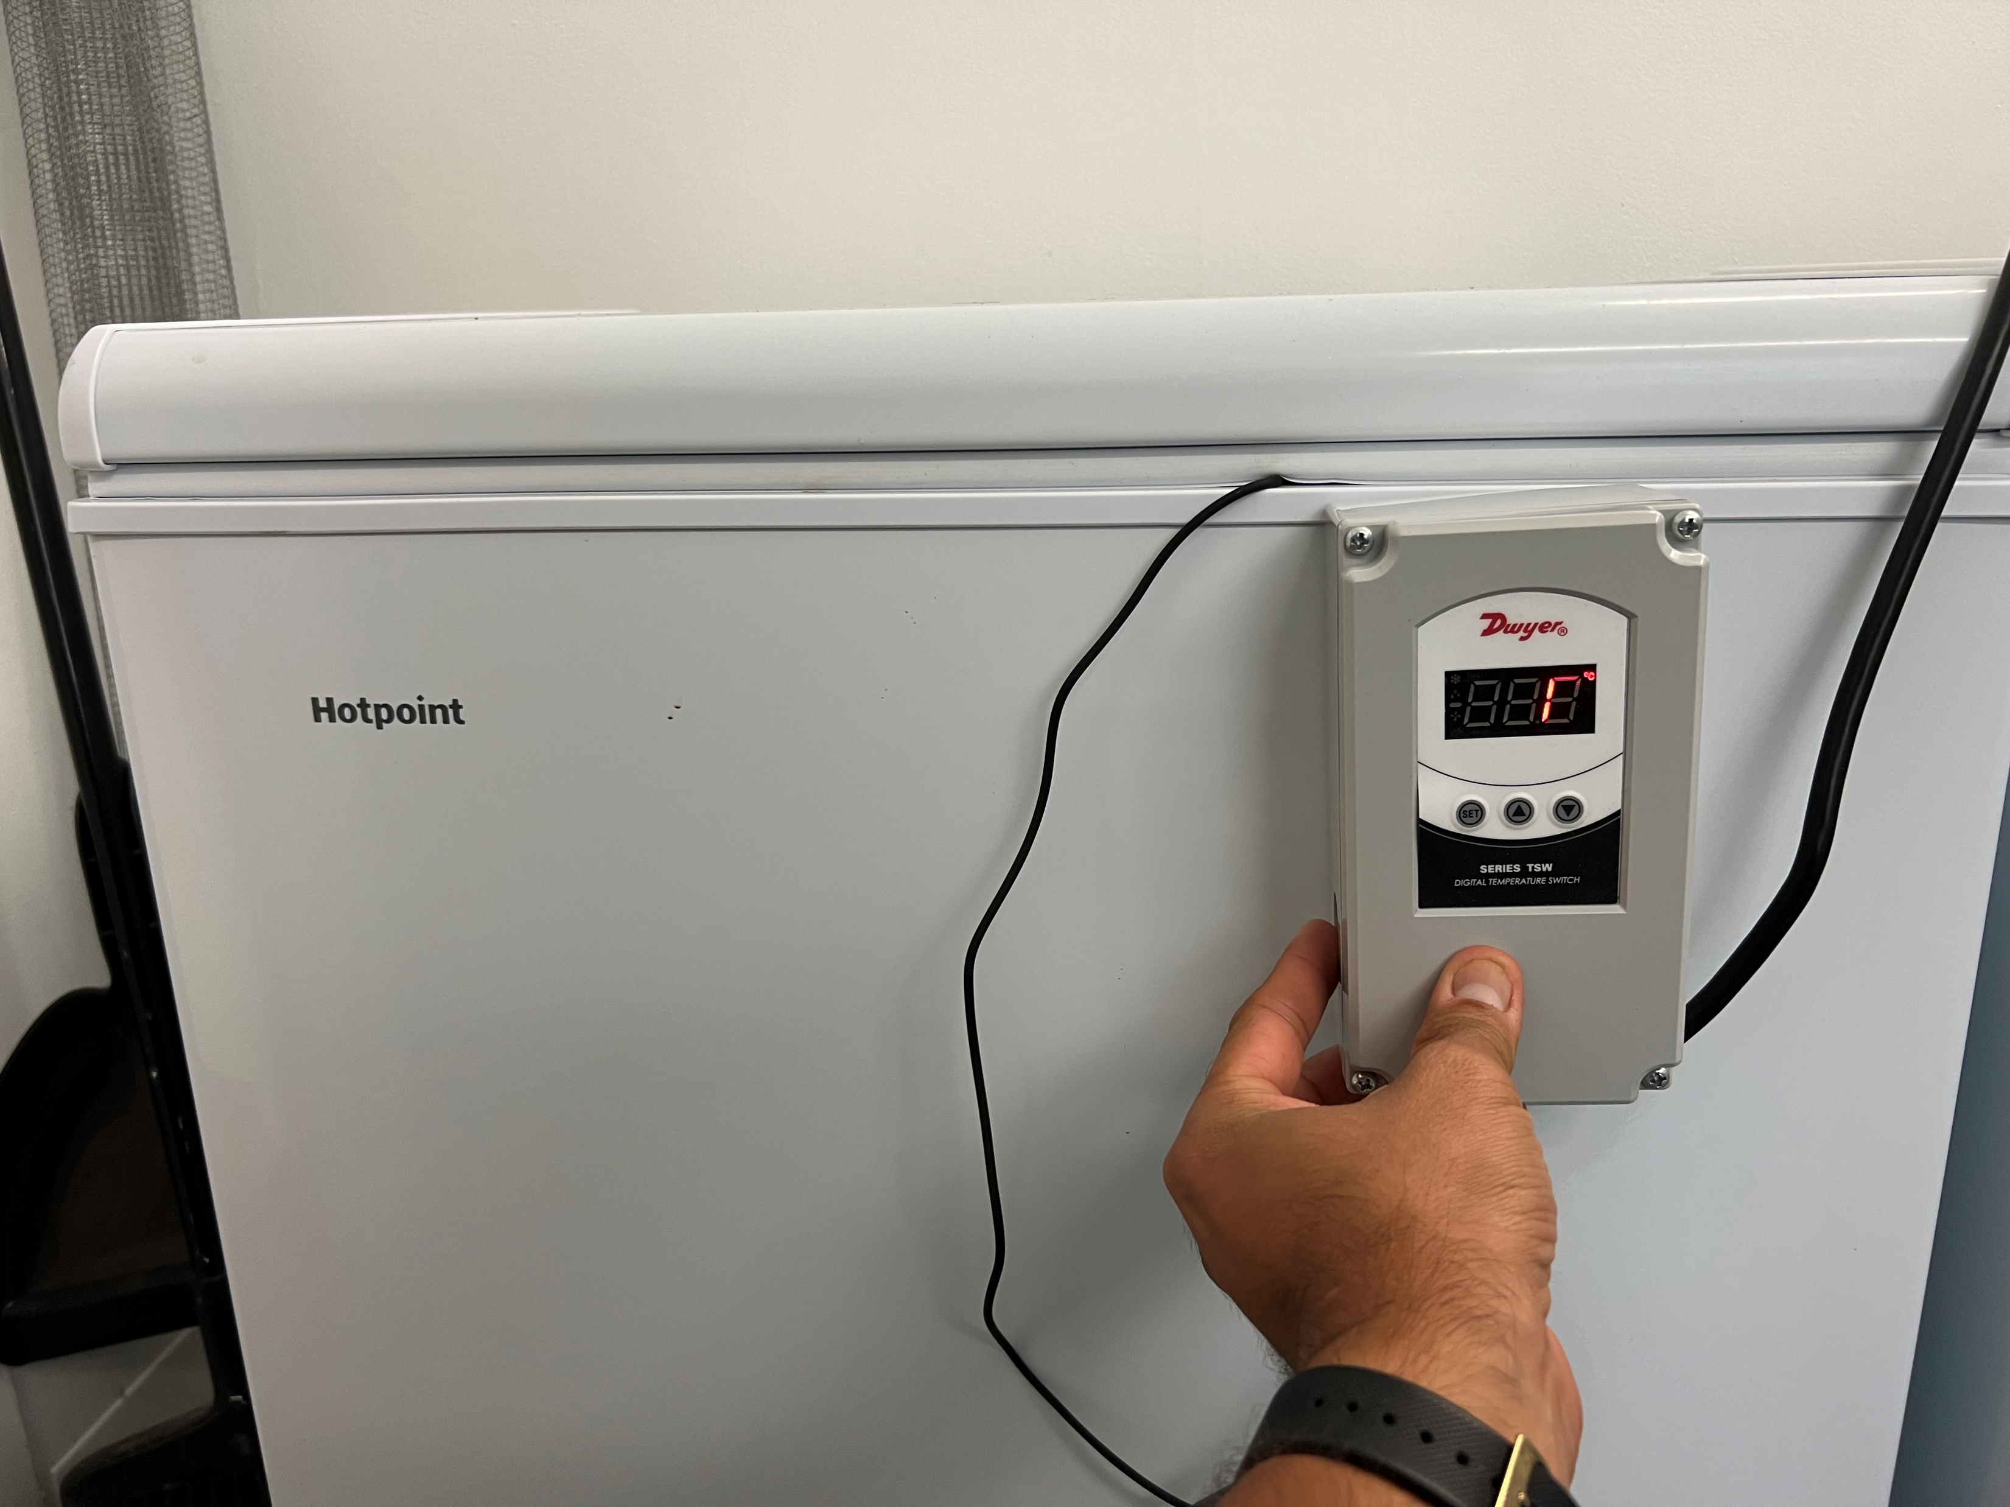

Slide 9
Seed Preparation Methodology
Freshly extracted citrus seed was purchased from a company in California
Fresh, wet, and untreated seeds were shipped via 2-day shipping to the Texas A&M Kingsville Citrus Center
Immediately upon receipt the seeds were rinsed and heat-treated in 50˚C water for 10 minutes
Seed quantity was estimated and split into 4 equal batches for drying

Slide 10
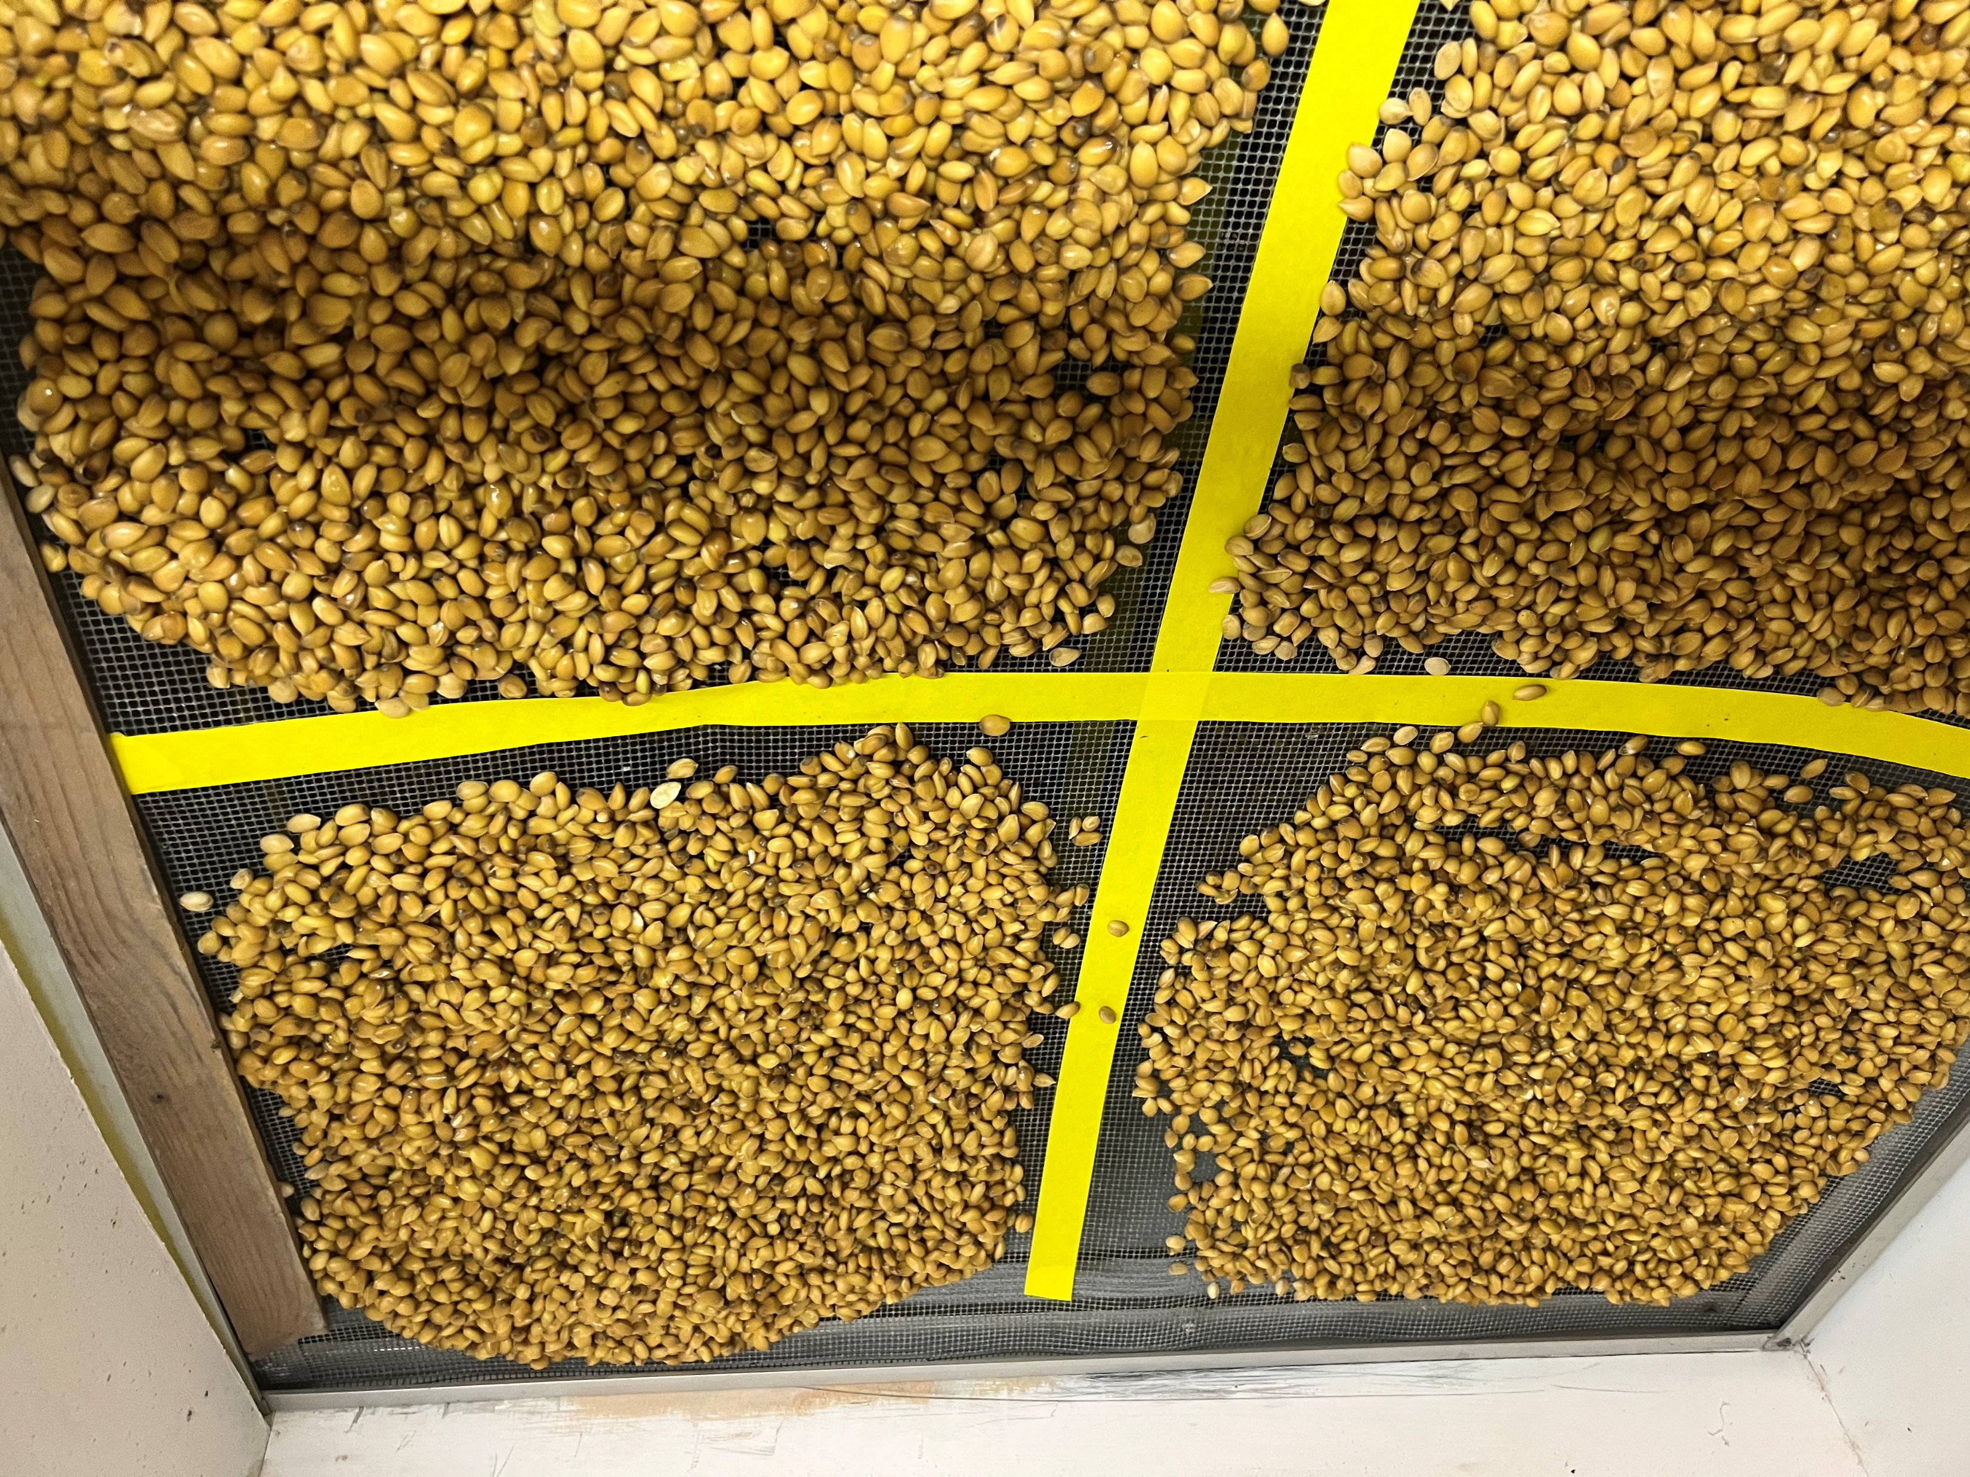

Slide 11
Methodology cont.
Seeds were placed into the drying chamber for either 24 hrs, 32, hrs, 48 hrs, or 72 hrs
Upon removal the seeds were separated into labeled individual plastic bags, and placed into the appropriate incubators
Bags were labeled indicating Variety-Drying Time-Incubation Temp-Planting Month
Seed batches were planted into premoistened Berger M6 potting mix in flat trays
An automatic water system was set up
Seedlings were counted 1-2 months post-planting

Slide 12
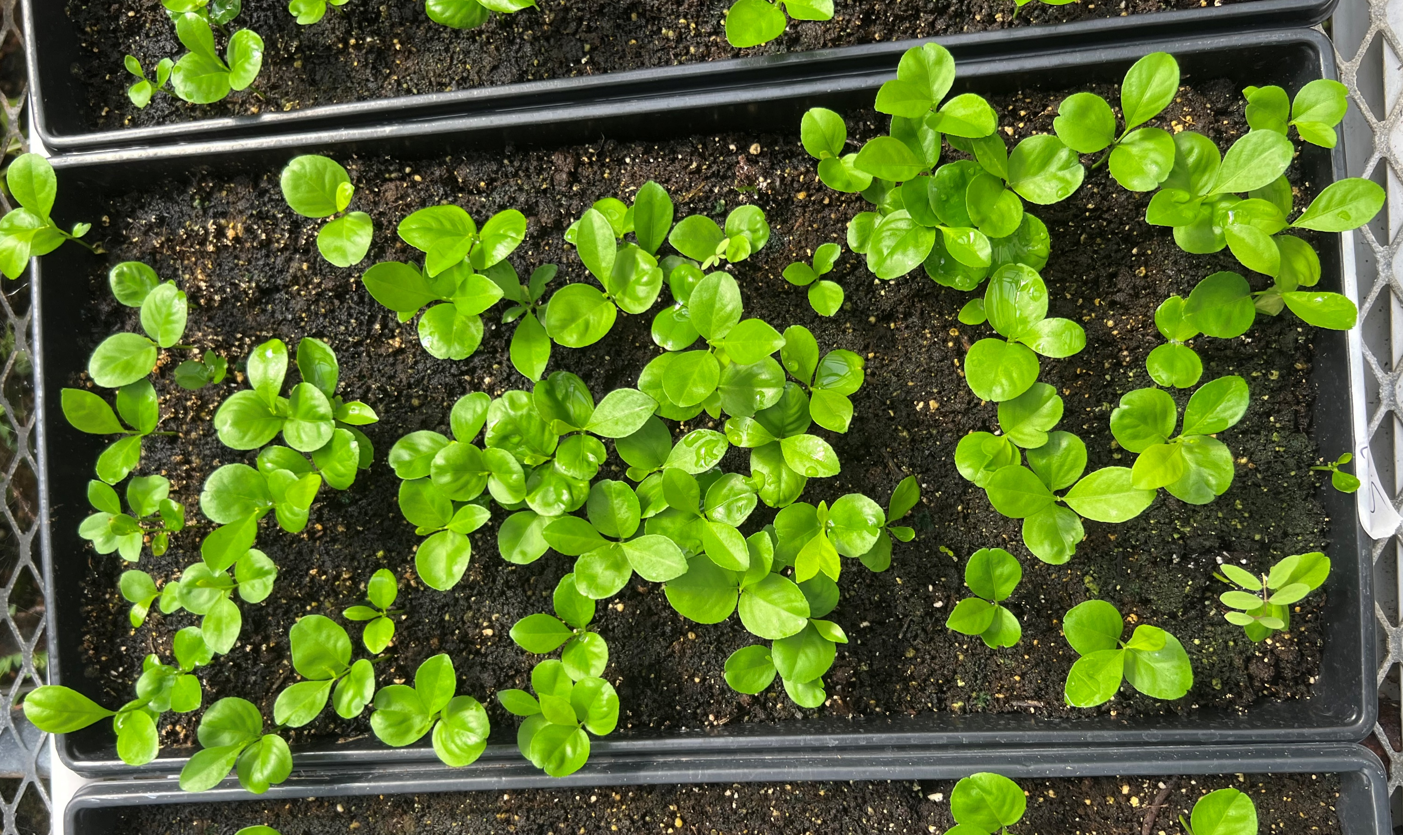

Slide 13
Results

Slide 14
Rubideaux trifolate
24 hours-25% moisture
32 hours-20% moisture
48 hours-11.5% moisture
72 hours-7% moisture
NOTE: 3 day shipping delay may have affected overall viability

Slide 15
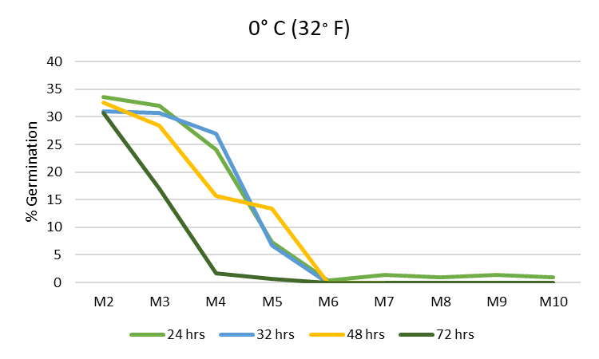
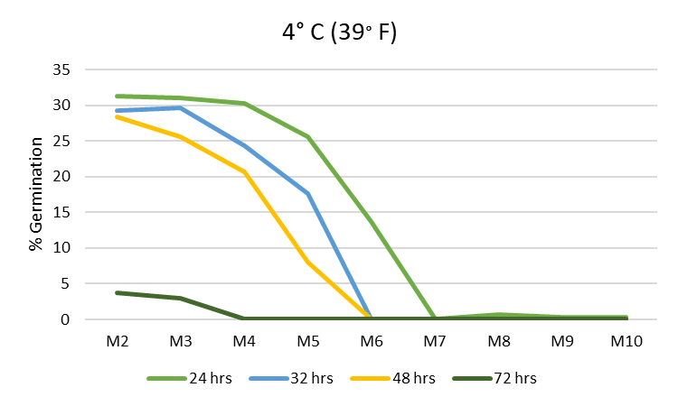
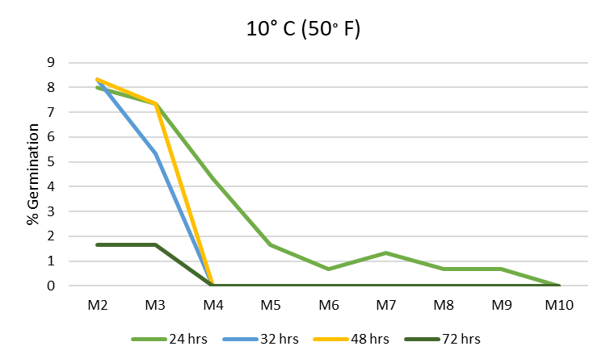
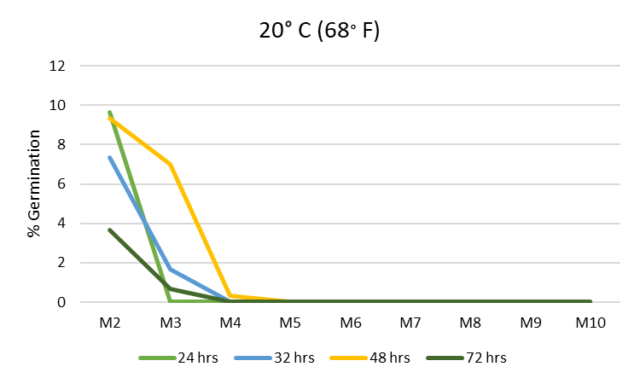

Slide 16
Carrizo
24 hours-22.6 % moisture
32 hours-14 % moisture
48 hours-5 % moisture
72 hours- 3.6% moisture

Slide 17
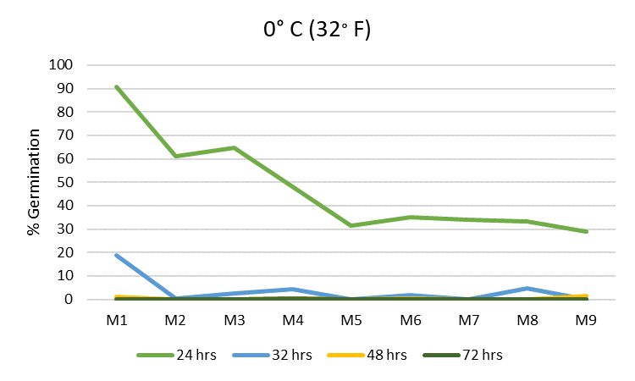
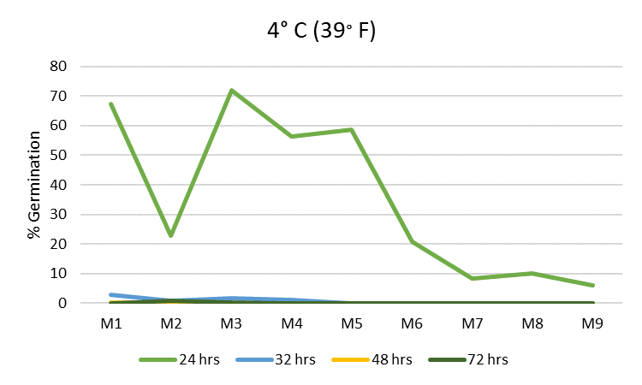
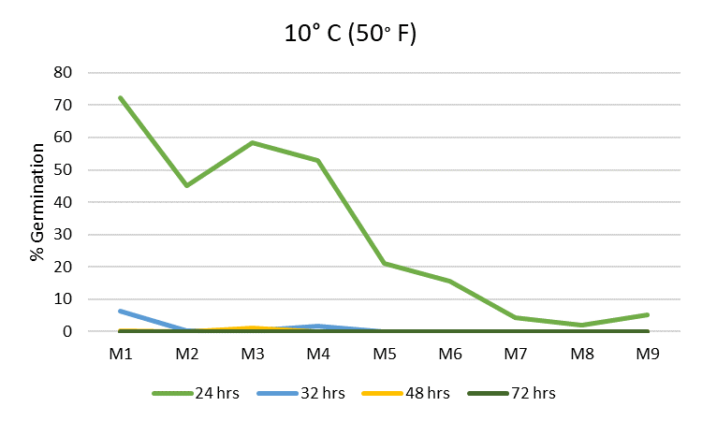
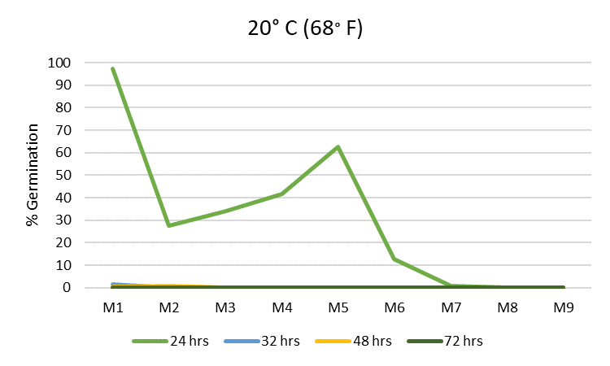

Slide 18
Sour orange
24 hours-24.1 % moisture
32 hours-17.7 % moisture
48 hours-12.1 % moisture
72 hours-3.8 % moisture

Slide 19
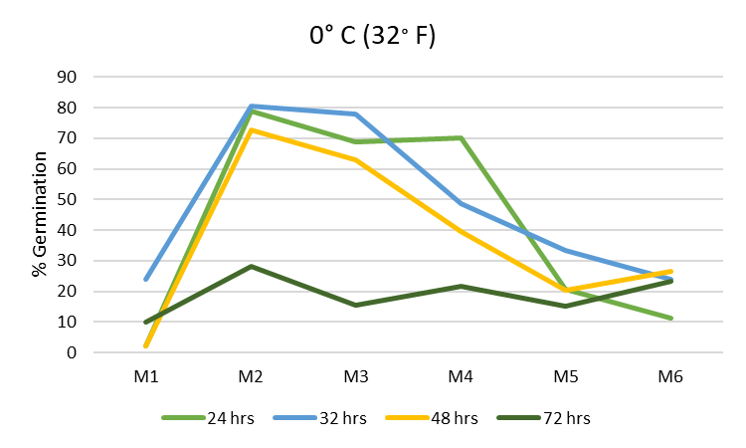
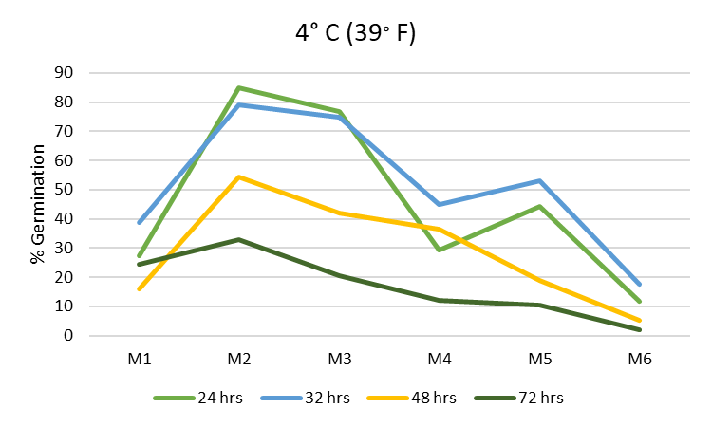
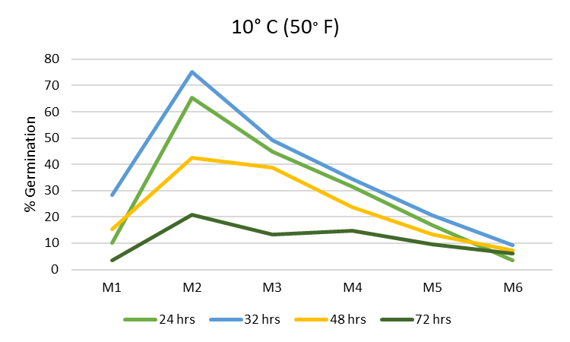
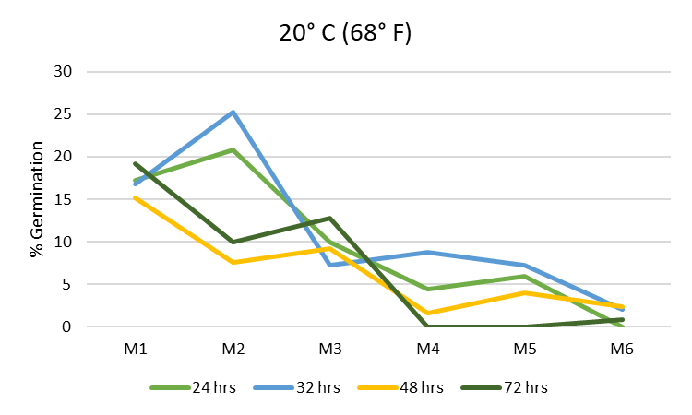

Slide 20
Discussion: Rubideaux trifoliate
Overall Rubideaux viability was low, possibly due to 3-day delay in transit while the seed was freshly extracted
25% and 20% seed moisture retained greater viability at 0° C and 4 ° C (32 ° F and 39 ° F) for up to month 4 after which overall viability fell to near 0 % by months 6 and 7

Slide 21
Discussion: Carrizo
22.6% moisture in Carrizo retained the best viability across all storage temperatures with best being at 0° C and 4 ° C (32 ° F and 39 ° F)
By month 5 at 0° C, viability dropped to about 30% and remained there through month 9
By month 5 at 4° C, viability dropped to about 60% but dropped significantly to below 10% by month 9
Month 10 seeds have been planted and we will do the final counts in several weeks

Slide 22
Discussion: Sour orange
Seed moistures of 24.1% and 17.7% retained the greatest viability across all storage temperatures except for 20° C, where all treatments lost viability rapidly
Seed moistures of 24.1% retained up to 80% viability at 0° C and a seed moisture of 17.7% retained a viability of almost 80 % up until month 3 at 4° C
We will keep planting up until month 10

Slide 23
Conclusions (tentative)
The higher moisture content seeds dried for either 24 hours or 32 hours across all varieties retained higher viabilities for longer times compared to the seeds dried for 48 or 72 hours
This further supports the storage of seeds in non-permeable bags
The storage temperatures that maintained the best viability were 0° C and 4 ° C (32 ° F and 39 ° F)
Carrizo in particular seems very sensitive to overdrying
Sour orange seems to be the most resilient

Slide 24
Future recommendations
The results of this study contrast with a study done by King et al. 1981 in which best viability was maintained at an internal moisture of 5% at stored at -20° C (-4° F) for lemon, lime, and sour orange
However, it seems that lower temperatures maintain greater viability over time, as confirmed by King et al.
We would recommend performing a similar study to examine the effects of below-freezing temperatures on the storage of citrus seed at different moisture contents

